Slide 1
WIOA Youth Eligibility
September 18th, 2023

Slide 2
Objective
The primary objective of this presentation is to inform the audience about the details around Workforce Innovation and Opportunity Act (WIOA) Youth Eligibility.

Slide 3
Federal Guidance
Workforce Innovation and Opportunity Act of 2014
Training and Employment Guidance Letter (TEGL) 21-16 – Third WIOA Title I Youth Formula Guidance – dated March 2nd, 2017
  Change 1 to TEGL 21-16 was issued July 30th, 2021 – Deals with the updated process for Determining Low Income for Youth Living in a High Poverty Area
TEGL 09-22 – WIOA Title I Youth Formula Guidance – dated March 2nd, 2023

Slide 4
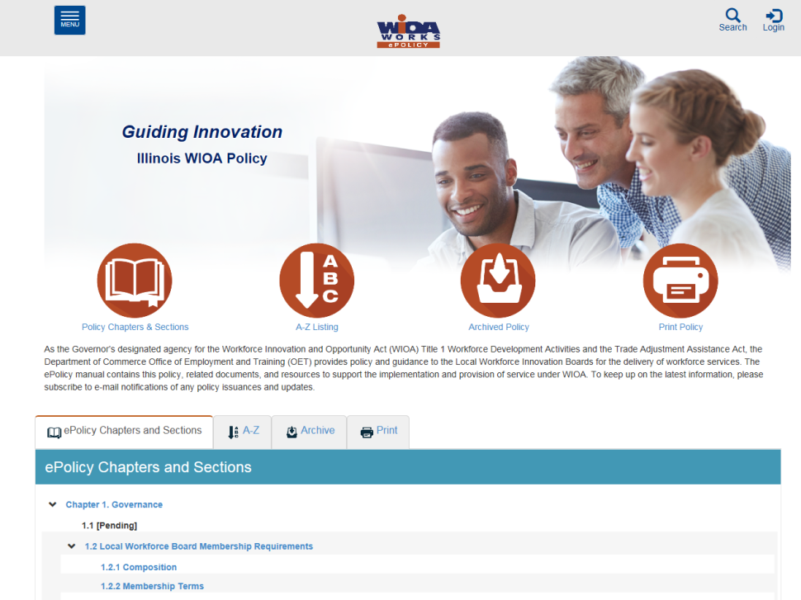
Understanding E-Policy Manual
The Illinois Department of Commerce and Economic Opportunity, Office of Employment and Training (OET) utilizes a WIOA ePolicy portal where all current and new guidance issued by the Illinois Workforce Innovation Board (IWIB) and OET is maintained.
Homepage: www.illinoisworknet.com/DCEOPolicies

Slide 5
State Guidance
WIOA ePolicy Chapter 5 - General Eligibility
WIOA ePolicy Chapter 5.1.1 – Selective Service updated August 2021
WIOA ePolicy Chapter 5.4 – General Youth Eligibility, 5/11/2023
WIOA ePolicy Chapter 5.4.1 – Out-of-School Youth, 5/11/2023
WIOA ePolicy Chapter 5.4.2 – In-School Youth, 5/11/2023
WIOA ePolicy Chapter 5.5 - Low-Income Individuals
WIOA ePolicy Chapter 5.9 Basic Skills Deficiency (BSD) Assessment Requirements, effective 5/17/2023

Slide 6
Local Policy/Guidance
Besides the guidance in Federal and State Policies, each Local Workforce Innovation Area (LWIA) has the latitude to establish additional Local Policy Guidance.
Chicago Cook Workforce Partnership does an exceptional job conducting tailored virtual trainings/webinars and has developed a Staff Training Guide that can be accessed on the Career Connect Zen Desk: LINK: https://workforceboard.zendesk.com/hc/en-us/articles/7760807734541--WIOA-Staff-Training-Guide-Worksheet (See next slide)

Slide 7
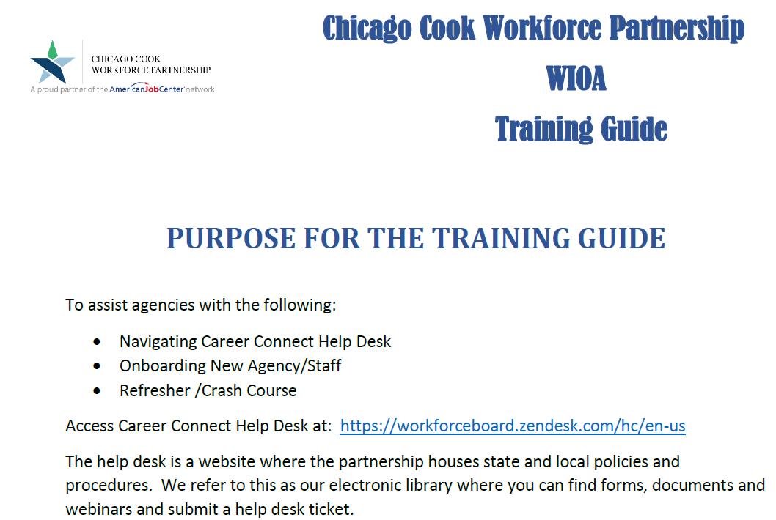
Local Policy/Guidance

Slide 8
WIOA Youth Eligibility
Prior to reviewing this power point on WIOA Youth Eligibility, if you did not participate in the live presentations, it is important that you view and understand the details that were covered in the 9-14-23 presentations:
  WIOA General Eligibility – posted on Zen Desk
  WIOA Low Income – posted on Zen Desk
  WIOA Basic Skills Deficient – posted on Zen Desk

Slide 9
WIOA General Eligibility
DCEO ePolicy – WIOA General Eligibility Policy 5.1
  All clients must be authorized to work in the U.S. before they meet WIOA General Eligibility.
  All clients born male, who have turned age 18 and were born on or after January 1st, 1960 must comply with Selective Service before they meet WIOA General eligibility.

Slide 10
WIOA Youth Eligibility
Workforce Innovation and Opportunity Act of 2014
  In-School Youth is a separate category from Out-of-School Youth and the eligibility between these two are significantly different.
  School Status is determined at the time of application, not what the individual will be going into while in the WIOA program.
  Whatever the school status is at certification, remains the same school status for Federal Reporting all through WIOA Youth Services and until the client is exited.

Slide 11
WIOA Youth Eligibility
The Workforce Innovation and Opportunity Act (WIOA) legislation and Training and Employment Guidance Letter (TEGL) 21-16 – Third WIOA Title I Youth Formula Guidance – have mirror guidance on requirements for Youth client assessment.
That guidance states that any individual who is going to be served under the Youth title must have a complete assessment prior to the client being determined eligible and enrollment in WIOA Youth Services.

Slide 12
WIOA Youth Assessment Requirements
Section 129(b)(2)(c)(1)(A) of WIOA Legislation States:
Career Coach must provide an objective assessment of:
Academic levels
Skill levels
Service needs of each participant
Review of basic skills
Occupational Skills
Prior work experience
Employability
Interests
Aptitudes (including interests and aptitudes for nontraditional jobs)
Supportive service needs
Development needs of the participant
The assessments must also consider a youth’s strengths rather than just focusing on areas that need improvement

Slide 13
WIOA Youth Program
The results of the Youth assessment are used to support enrollment in the WIOA Youth program, and that assessment is used to create the Youth clients initial Individual Service Strategy (ISS) that is the basis to support the individual being brought into the WIOA Youth Program.

Slide 14
Individual Service Strategy (ISS)
The ISS is an agreement of objectives and goals decided between the WIOA Youth participant and WIOA Youth Career Coach that sets out a plan for the participant to make progress towards his/her educational and employment goals.

Slide 15
Guidance from TEGL 21-16
    For purposes of WIOA, providers of adult education under Title II of WIOA, YouthBuild programs, the Job Corps program, high school equivalency programs, and dropout re-engagement programs are not considered to be schools for the purposes of determining school status, with one exception:
      Youth attending high school equivalency (HSE) programs, including those considered to be dropout re-engagement programs, funded by the public K–12 school system that are classified by the school system as still enrolled in school are considered ISY.

Slide 16
Determining School Status in Career Connect
Within Career Connect, on the Education tab of the WIOA Application is where the question to determine if an individual is an In-School Youth (ISY) or an Out-of-school Youth (OSY).
The “School Status at Youth Program eligibility” is the question that will determine if an individual is considered an “In School Youth” (ISY) or an “Out-of-School Youth” (OSY).

Slide 17
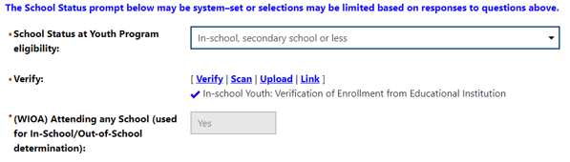
Determining In-School Youth
In the Career Connect application, if the question of “School Status at Youth Program eligibility” is populated showing the client is currently In school, either in secondary or post secondary school, internal logic will determine the client as an ISY.

Slide 18
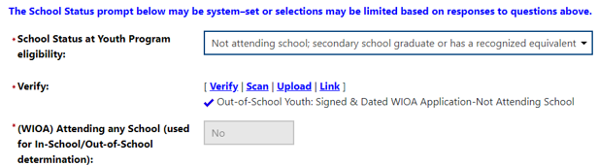
Determining Out-of-School Youth
In the Career Connect application, if the question of “School Status at Youth Program eligibility” is populated with Not attending school, the internal Career Connect logic will determine the client as an OSY.

Slide 19
WIOA In-School Youth
WIOA E-Policy Chapter 5.4.2 – In-School Youth:
    In-School Youth – Youth not younger than age 14 or older than age 21
      Attending school (as defined by state law)

Slide 20
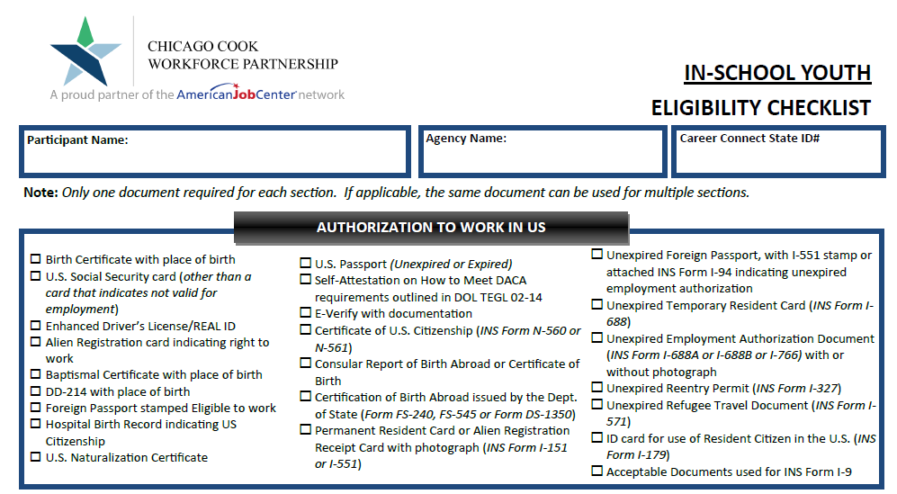
Partnership March 2022 ISY Checklist

Slide 21
WIOA In-School Youth
WIOA ePolicy Chapter 5.4.2 – In-School Youth:
  95% of the In-School Youth must meet low-income criteria (see WIOA ePolicy Chapter 5.5 - Low-Income Individuals)
As mentioned earlier, it is essential that you have viewed and understand the previous PowerPoint on WIOA Low Income that is posted on the Zen desk, so you understand the eight different ways an In-School Youth client could meet WIOA Low Income criteria.
Lastly, all In-School Youth clients must have one or more of the following barriers shown on the next slide.

Slide 22
WIOA In-School Youth Barriers
Basic Skills Deficient
An English Language Learner
An Offender
Homeless
Runaway
Foster Child or aged out of foster care
Pregnant or Parenting
An individual with a disability
An individual requiring additional assistance to enter or complete an educational program or to secure or hold employment.

Slide 23
Basic Skills Deficient Definition
Basic Skills Deficient – respect to an individual— (A) who is a youth, that the individual has English reading, writing, or computing skills at or below the 8th grade level on a generally accepted standardized test; or (B) who is a youth or adult, that the individual is unable to compute or solve problems, or read, write, or speak English, at a level necessary to function on the job, in the individual’s family, or in society.

Slide 24
Ways to be Basic Skills Deficient
As was covered in the separate presentation on Basic Skills Deficient (BSD), there are three different ways an individual could meet BSD criteria:
  Scoring at or below 8th Grade Level Equivalency (GLE) on their pre-assessment math or reading tests.
  Being determined BSD due to the Basic Skills Screening Tool.
  If a Youth Client is assessed as an English Language Learner (ELL), they are also considered BSD.

Slide 25
Basic Skills Deficient from Testing
An important detail that I have been asked to stress, when assessment tests are being recorded on a client in Career Connect, even though the Grade Level Equivalency (GLE) is not required field on the screen, you must record the clients accurate GLE to get proper credit for Federal Reporting.

Slide 26
Within Career Connect
Within Career Connect, on the “Barriers” screen within the application, is where the question related to Basic Skills Deficient is recorded when a client has scored at or below 8 Grade Level on their pre-assessment Math or Reading test.

Slide 27
Within Career Connect
If you have an assessment test dated on or prior to the clients WIOA application date that would support the client being BSD, you record “Yes” to the Basic Skills Deficient/Low Levels of Literacy question, then for the documentation under “verify”, the documentation would be the “Results from an Authorized Assessment Test”.

Slide 28
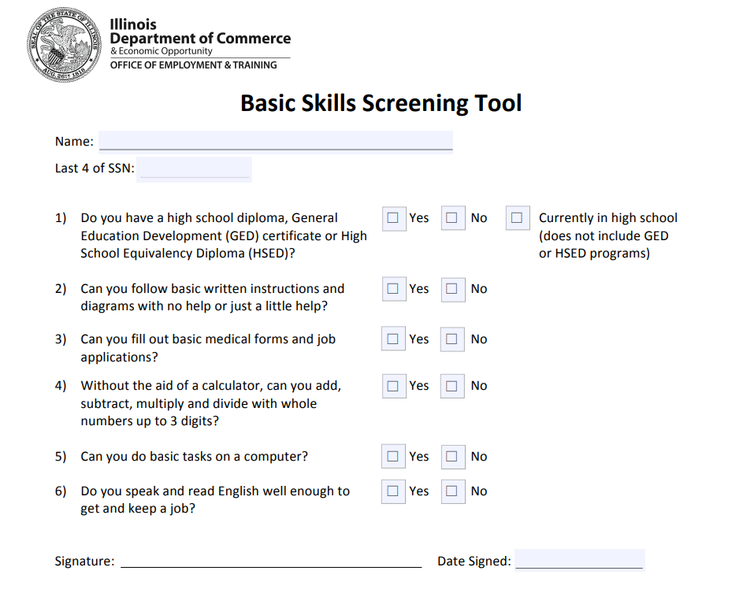
Basic Skills Screening Tool
We will now transition to the next way a client could be determined BSD.
Based on guidance in WIOA ePolicy Chapter 5.9 Basic Skills Deficiency (BSD) Assessment Requirements:
  Attachment “A” within this policy is a Basic Skills Screening Tool (see example on adjacent slide.)
  If a client has a response of “No” to any of the questions on the screening tool, they will be determined BSD.

Slide 29
Basic Skills Screening Tool
Within Career Connect, on the “Barriers” screen within the application, is where the question has been added when a client is being determined BSD due to the new screening tool.
If any question on the screening tool is answered “No” by the client, then the question related to the BSD screening tool on the “Barriers” screen should be answered “Yes”; (see example on next slide).

Slide 30
Basic Skills Screening Tool
Demonstrating recording BSD due to the screening tool on the Education Status screen within the application in Career Connect:

Slide 31
Basic Skills Screening Tool
It is important to understand, the basic skills screening tool does not take the place of assessment testing.
The purpose of the screening tool is to capture the criteria under the second part of the “Basic Skills Deficient” definition which is “a youth or adult, that the individual is unable to compute or solve problems, or read, write, or speak English, at a level necessary to function on the job, in the individual’s family, or in society.”

Slide 32
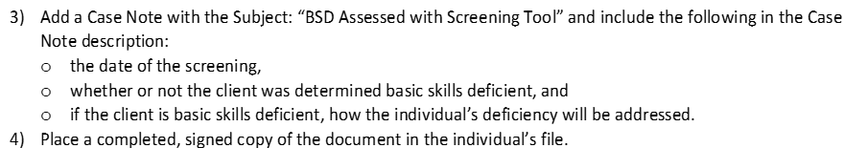
Case Note in Career Connect Required
Please note, when any WIOA client is being determined Basic Skills Deficient due to one or more “No” responses by the client on the Basic Skills Screen Tool, the guidance below must be followed:

Slide 33
Basic Skills Screening Tool
If a client is being indicated as meeting BSD criteria due to the Basic Skills Screening tool, the only acceptable documentation to support this criteria is the completed screening tool (with one or more response(s) of “No” indicated on the tool).
The screening tool must have been signed and dated by the client and the bottom portion of the screening tool must be completed by Career Planer staff (see example of bottom of tool on next slide.)

Slide 34
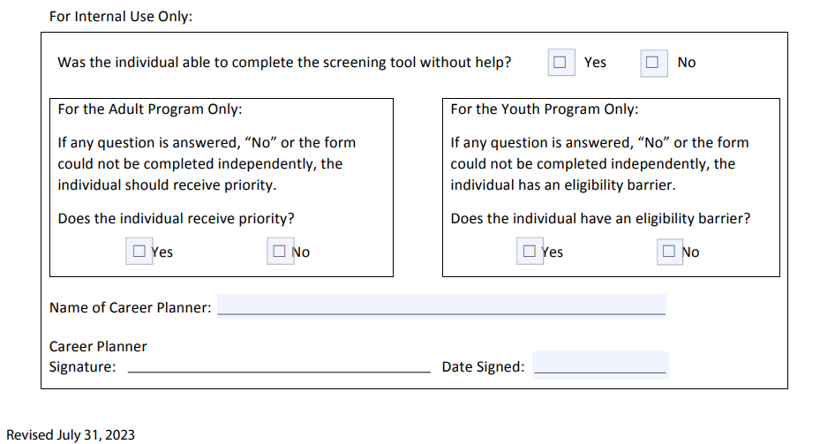
Bottom Portion of the Basic Skills Screening Tool

Slide 35
English Language Learner
English Language Learner – the term “English language learner” when used with respect to an eligible individual, means an eligible individual who has limited ability in reading, writing, speaking, or comprehending the English language, and (A) whose native language is a language other than English; or (B) who lives in a family or community environment where a language other than English is the dominant language.

Slide 36
English Language Learner
Within Career Connect, on the “Barriers” tab within the application, is a question, “Do you primarily speak a language other than English?”
If the question is populated with a “Yes”, the client will meet the barrier as an English Language Learner (ELL). (See example on next slide.)

Slide 37
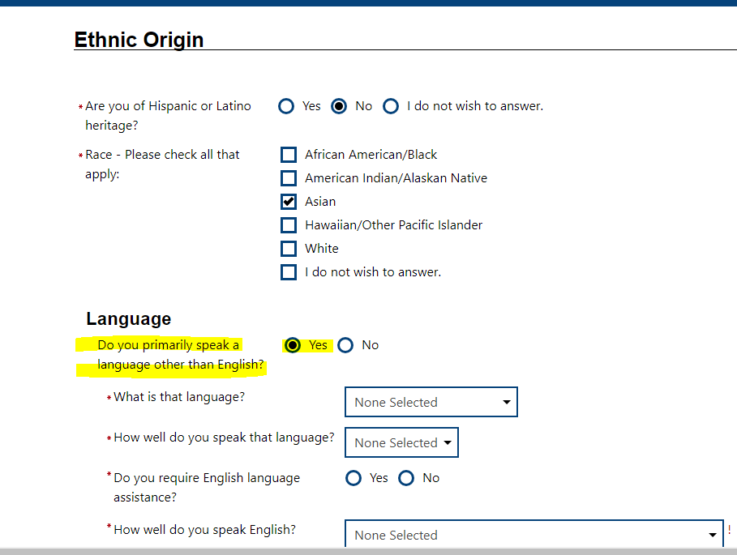
English Language Learner
Demonstrating recording English Language Learner within Career Connect;

Slide 38
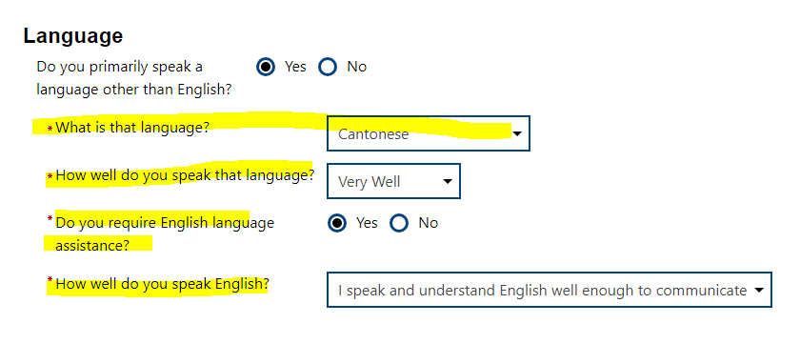
English Language Learner
In Career Connect, if a client is identified as an English Language Learner, the client must indicate a language of preference:

Slide 39
Recap of Basic Skills Deficient
If an individual scores at or below 8th Grade Level on either their Math or Reading Assessment test they would be determined BSD.
An individual can be determined BSD using the Basic Skills Screening Tool.
Lastly, if an individual is assessed as an English Language Learner (ELL), they are also determined to meet BSD criteria.

Slide 40
Youth Offender Barrier
Offender - An adult or youth (A) who is or has been subject to any stage of the criminal justice process, for whom services under this Act may be beneficial; or (B) who requires assistance in overcoming artificial barriers to employment resulting from a record of arrest or conviction.

Slide 41
Youth Homeless Barrier
Individual who lacks a fixed, regular or adequate nighttime residence; as defined in the Violence Against Women Act of 1994, or
Adult or youth with a primary nighttime residence that is a public or privately operated shelter for temporary accommodation as defined in the McKinney-Vento Homeless Assistance Act
Note: Meeting criteria of “Homeless” is also an automatic WIOA Low Income criteria.

Slide 42
Youth Foster Child Barrier
Foster Child - A minor on behalf of whom State or local government payments are made to a foster parent or other guardian.
Meeting the criteria of a Foster Child is not only a barrier under WIOA Youth Eligibility, if an individual is a Foster Child it is also an automatic WIOA Low Income criteria.

Slide 43
Aged Out of Foster Care
“Youth Aged Out of Foster Care” – is simply that, an individual who was a Foster Child, that once became of the legal age where the foster system no longer were considering the individual a foster child.
It would also be appropriate to identify an individual with the barrier of “Aged Out of Foster Care” for someone who had been a foster child that was adopted prior to aging out of foster care.

Slide 44
Youth Runaway Barrier
A “Runaway” is defined as a person under the age of 18 who absents himself or herself from home or place of legal residence without the permission of a parent or legal guardian.
When utilizing the “Runaway” barrier for a Youth client, it could be challenging due to the requirements for the parent/guardian to provide written consent for the minor to participate in the WIOA Program.

Slide 45
Pregnant or Parenting Barrier
Pregnant could only be considered a barrier for the female clients;
Both male and female could be a parent once a child has been born.

Slide 46
An Individual with a Disability
An individual with any disability (as defined in section 3 of Americans with Disabilities Act of 1990 (42 U.S.C12102)).
In addition, in situations where the client has a disability, there could be WIOA Low Income criteria under “Family of One Due to a Disability”.
  Family of one Due to a Disability could be used for situations where an individual that has a disability, whose family is over WIOA income guidelines, but the income of the client who has the disability is less than the $14,580 (which is the income level for family size of one for all LWIA’s since the issuance of WIOA Notice No. 22-NOT-01 that was released on May 12th, 2023.)

Slide 47
Youth Needing Assistance
Under Youth eligibility, there is a barrier for, “An individual requiring additional assistance to enter or complete an educational program or to secure or hold employment.”
It is important to understand that the criteria to support this barrier is determined by each Local Workforce Innovation Area (LWIA) in their own Local Policy.
  If this barrier is indicated in an application, staff must explain in the case note (or with appropriate documentation), how the client meets the criteria that is laid out within the LWIA Local Policy.

Slide 48
Youth Requiring Additional Assistance Limitations
In TEGL 09-22 that was released on March 2nd, 2023, updated guidance that states only record the barrier of “An individual requiring additional assistance to enter or complete an educational program or to secure or hold employment.” when it is a participant’s sole eligibility barrier.
Guidance in TEGL 09-22 states, “WIOA includes a limitation where in each local area only five percent of in-school youth in a given program year can be determined eligible using this barrier”.

Slide 49
Limited to only 5% of ISY
As was previously passed on, TEGL 09-22 provided guidance that “WIOA includes a limitation where in each local area only five percent of in-school youth in a given program year can be determined eligible using this barrier”.
OET WIOA ISY Youth Policy 5.4.2, that was issued on May 11st, 2023 states under paragraph 1.d.7) - an individual who requires additional assistance to complete an educational program or to secure or hold employment.
  a) This criterion can only be used when no other youth barriers exist.
  b) Local Workforce Innovation Boards (LWIBs) must establish a local policy using this criterion.
  c) LWIBs must ensure that less than five (5) percent of their ISY per program year utilize and report this barrier as the sole reason for eligibility determination.

Slide 50
LWIA 7 Local Guidance
LWIA 7 has local policy guidance related to the Youth Barrier of, “An individual requiring additional assistance to enter or complete an educational program or to secure or hold employment.”
https://workforceboard.zendesk.com/hc/en-us/articles/115000831652-Youth-Eligibility

Slide 51
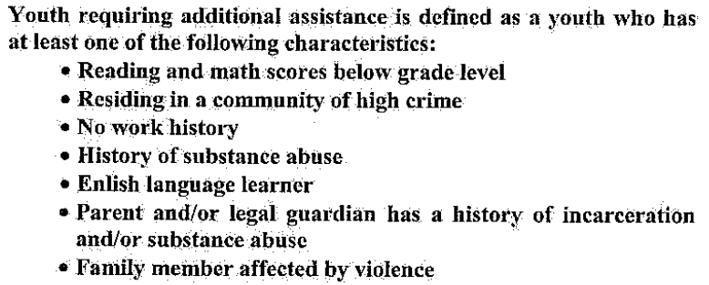
Youth Requiring Assistance
In LWIA 7 local policy number 2018-PL-06, Change 1, it has the details listed on the adjacent screen print as the locally determined “Youth Requiring Additional Assistance” barrier criteria.

Slide 52
ISY – Limitations to “Youth Needing Assistance” Barrier
Again, for an ISY, the barrier of “Youth Needing Additional Assistance” should only be used when the client has no other WIOA Youth barriers, and when the individual would meet locally established criteria.
Additionally, as mentioned, there is a limitation that only 5% of the ISY can utilize the barrier of “Youth Needing Additional Assistance”.

Slide 53
Case Note How Criteria was Met
It is important to understand the criteria to support this barrier is determined by each Local Workforce Innovation Area (LWIA) in their own Local Policy.
  So, if this barrier is indicated in an application, staff must explain in the case note, how the client meets the criteria that is laid out within the LWIA Local Policy guidance on this barrier.

Slide 54
Concludes In-School Youth (ISY)
This concludes the portion of the presentation on ISY. Key points to remember are that for an ISY, the Youth is required to meet WIOA Low-Income criteria and have one or more of the identified Youth barriers.
The Youth barrier of “An individual requiring additional assistance to enter or complete an educational program or to secure or hold employment.” may only be used on a maximum of 5% of the LWIA’s total ISY in a program year.
If an ISY completes school while in the WIOA program, they will still maintain their status as an ISY until they exit from the WIOA program.

Slide 55
Out-of-School Youth Program
WIOA E-Policy Chapter 5.4.1 – Out-of-School Youth
  Out-of-School Youth – Youth not younger than age 16 or older than age 24;
  Not attending any school as defined under state law;
  Individuals attending Adult Education provided under Title II of WIOA, YouthBuild or Job Corps are also classified as out-of-school youth for eligibility determination.

Slide 56
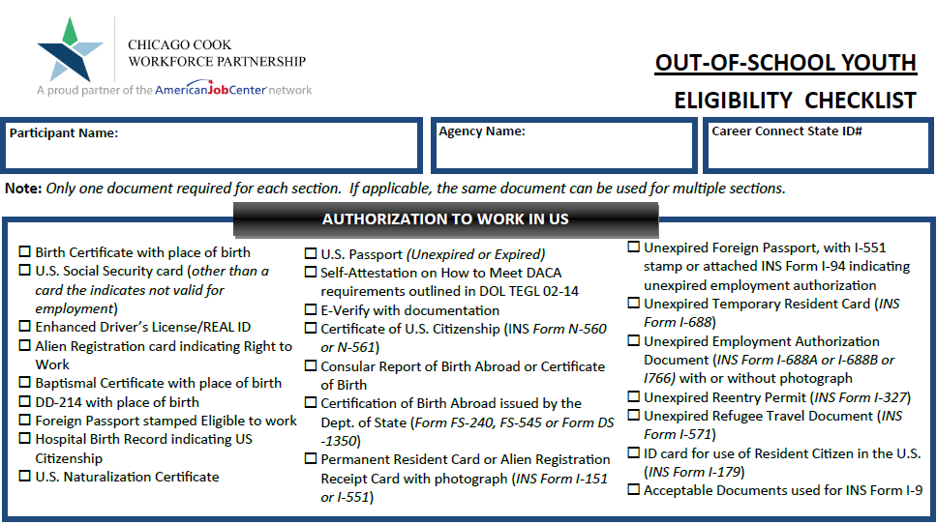
Partnership March 2022 OSY Checklist

Slide 57
Guidance from TEGL 21-16
  If a youth graduates' high school and registers for postsecondary education, they would be considered an ISY at the time of application.
  However, if the youth does not ultimately follow through with attending postsecondary education, then such a youth would be considered an OSY if the eligibility determination is made after the point that the youth decided not to attend postsecondary education.
  If the youth is only enrolled in non-credit-bearing postsecondary classes, they would not be considered attending postsecondary school and, therefore, an OSY.

Slide 58
Out-of-School Youth
The following out-of-school youth barriers do not require the individual to meet low-income criteria:
School Dropout;
Within the age of compulsory attendance but has not attended school for at least the most recent complete school year quarter;
Subject to the juvenile or adult justice system;
Homeless
Runaway
Foster Care
Aged Out of Foster Care
Pregnant or Parenting
An Individual with a Disability

Slide 59
High School Dropout
This barrier can only be used for an individual who drops out of High School and has not gone back to school. If they dropped out but went back or obtained their General Equivalency Degree (GED), they are not considered a “Drop Out” under WIOA Eligibility.
Within Career Connect, on the “Education Status” screen within the application, if the question of “High School Dropout” is answered with “Yes”, it would meet the criteria for the OSY barrier of “High School Dropout”.

Slide 60
Not Attended High School in Quarter
In some instances, a High School might not consider an individual to be a High School Drop Out until the end of a school year.
Under the WIOA legislation, the Out-of-School Youth barrier of “Within the age of compulsory attendance but has not attended school for at least the most recent complete school year quarter” was added for this reason.

Slide 61
Subject to Justice System
Under the WIOA legislation, under In-School Youth (ISY), there is a barrier for an ”Offender”. For the Out-of-School Youth (OSY), this barrier is called, “Subject to the juvenile or adult justice system.”
In the March 2017, TEGL 21-16 – WIOA Youth guidance it was clarified that the OSY barrier of “Subject to the juvenile or adult justice system” has the same definition as the ISY barrier of “Offender”.

Slide 62
Subject to Justice System
An adult or youth is “Subject to the Juvenile or Adult Justice System” if, (A) who is or has been subject to any stage of the criminal justice process, for whom services under this Act may be beneficial; or (B) who requires assistance in overcoming artificial barriers to employment resulting from a record of arrest or conviction.

Slide 63
Out-of-School Youth Barriers
The other Out-of-School Youth barriers that do not require a client to meet WIOA low-income criteria are shown in the adjacent column; we have already covered the details where those questions are addressed within the In-School Youth eligibility.
Homeless
Runaway
Foster care
Aged out of foster care
Pregnant or parenting
An individual with a disability

Slide 64
Out-of-School Youth Barriers
If an Out-of-School Youth (OSY) did not meet any of the previously addressed barriers, there are two more possible barriers that could support OSY eligibility, but both require the client to meet WIOA Low-Income criteria with the barrier.

Slide 65
Out-of-School Youth Barriers
The following Out-of-School Youth barriers require the individual to meet WIOA low-income criteria:
A recipient of a secondary school diploma or its recognized equivalent who is a low-income individual and is
  Basic Skills Deficient, or
  An English language learner
A low-income individual requiring additional assistance to enter or complete an educational program or to secure or hold employment (must be supported based on local policy criteria.)

Slide 66
High School Diploma or GED and is either BSD or ELL
For this barrier, the client will need to have been an OSY that has already graduated H.S. or completed their GED but is Basic Skills Deficient or an English Language Learner as was discussed and demonstrated previously in this PowerPoint.

Slide 67
Youth Requiring Assistance
Under Youth eligibility, for the barrier, “An individual requiring additional assistance to enter or complete an educational program or to secure or hold employment.”
It is important to understand the criteria to support this barrier is determined by each Local Workforce Innovation Area (LWIA) in their own Local Policy.
  As previously mentioned, if this barrier is indicated in an application, staff must explain in the case note, how the client meets the particular criteria that is laid out within the LWIA Local Policy guidance on this barrier.

Slide 68
LWIA 7 Out-of-School Youth – Youth Requiring Additional Assistance
As stated earlier, it is my understanding that LWIA 7 - Policy No. 2018-PL-06 Change 1, September 2018 is the current local policy on Youth Eligibility.
In that local policy, it has the details listed on the adjacent screen print as the “Youth Requiring Additional Assistance” barrier criteria.

Slide 69
WIOA 5% Non-Low-Income Youth Rule
A last point to cover for Youth, WIOA Legislation allows for a LWIA to serve up to 5% of their Youth, that are required to meet WIOA Low-Income criteria as part of the eligibility (either ISY or OSY), who do not in fact meet WIOA Low-Income criteria.
The Youth is still required to have at least one or more of the Youth barriers.
Each LWIA is responsible for tracking their own 5% Youth non-low-income, so check with the individual who is responsible for providing oversight of your Youth program if you feel you have a good client for the 5% Youth criteria

Slide 70
Youth Wrap Up
In conclusion – all WIOA Youth must meet WIOA General Eligibility tied to Authorized to Work in the U.S. criteria. All clients born male who have turned age 18 must be in compliance with Selective Service.
95% of In-School Youth must meet WIOA Low-Income criteria and have at least one or more of the identified Youth Barriers.
For Out-of-School Youth, most of the clients are not required to meet WIOA Low-Income criteria unless their only barriers are tied to being a High School Graduate who is Basic Skills Deficient or an English Language Learner, or if the Youth Needing Assistance barrier is the only barrier.

Slide 71
Concludes this PowerPoint
This concludes the presentation on building a WIOA Youth Eligibility.
Please contact your Regional Manager or Project Coordinator for any questions.

