Slide 1
WIOA Dislocated Worker Eligibility Tailored for LWIA 7
September 19th, 2023

Slide 2
Objective
The primary objective of this presentation is to inform the audience about the intricate details around the Updated Workforce Innovation and Opportunity Act (WIOA) Dislocated Worker Eligibility Policy Chapter 5 Section 3
The secondary objective of this presentation is to discuss and describe how the various Dislocated Worker criteria in the Career Connect system that LWIA 7 staff use as their Management Information System for WIOA records

Slide 3
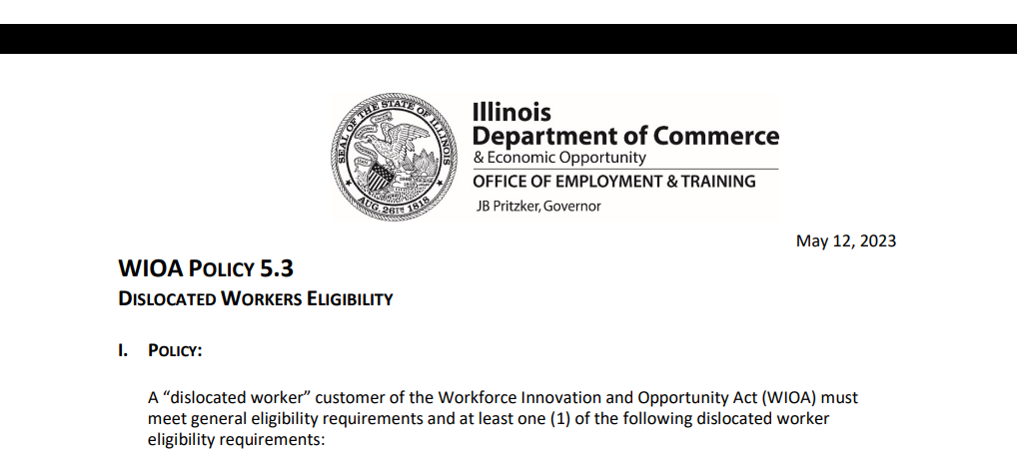
WIOA Policy 5.3 – Dislocated Worker Eligibility
This updated/new policy was issued on May 12th, 2023:

Slide 4
WIOA Dislocated Worker Eligibility
WIOA Title 1 Authority
Workforce Innovation and Opportunity Act of 2014
Training and Employment Guidance Letter (TEGL)19-16 – Guidance on Services Provided through Adult and Dislocated Worker under WIOA – dated March 2nd, 2017
WIOA ePolicy Chapter 5.1 – General Eligibility
WIOA ePolicy Chapter 5.1.1 – Selective Service updated August 2021
WIOA ePolicy Chapter 5.3 – Dislocated Worker Eligibility updated May 12th, 2023

Slide 5
Local Policy/Guidance
Besides the guidance in Federal and State Policies, each Local Workforce Innovation Area (LWIA) has the latitude to establish additional Local Policy Guidance
Chicago Cook Workforce Partnership does an exceptional job conducting tailored virtual trainings/webinars and has developed a Staff Training Guide that can be accessed on the Career Connect Zen Desk: LINK: https://workforceboard.zendesk.com/hc/en-us/articles/7760807734541--WIOA-Staff-Training-Guide-Worksheet (See next slide)

Slide 6
Local Policy/Guidance

Slide 7
WIOA General Eligibility
Prior to reviewing this presentation on Dislocated Worker Eligibility, it is important that you understand the details that were covered during the 9-14-2023 presentation on WIOA General Eligibility; which went into details about Authorized to Work in the U.S.; and compliance with Selective Service, and when appropriate “Locally Approved Selective Service Waiver”
If you did not participate in the 9-14-2023 training, the recording is posted on the Zen Desk

Slide 8
WIOA General Eligibility
DCEO ePolicy – WIOA General Eligibility Policy 5.1
All clients must be authorized to work in the U.S. before they meet WIOA General Eligibility
All clients born male, who have turned 18 and were born on or after January 1, 1960, must comply with Selective Service before they meet WIOA General eligibility

Slide 9
Dislocated Worker Eligibility
WIOA ePolicy Chapter 5.3 Dislocated Worker Eligibility:
Unlikely to Return to Previous Industry or Occupation
Plant Closure or Substantial Layoff
UI Profilee
No Longer Self-Employed
Displaced Homemaker
Spouse of a member of the Armed Forces on active duty

Slide 10
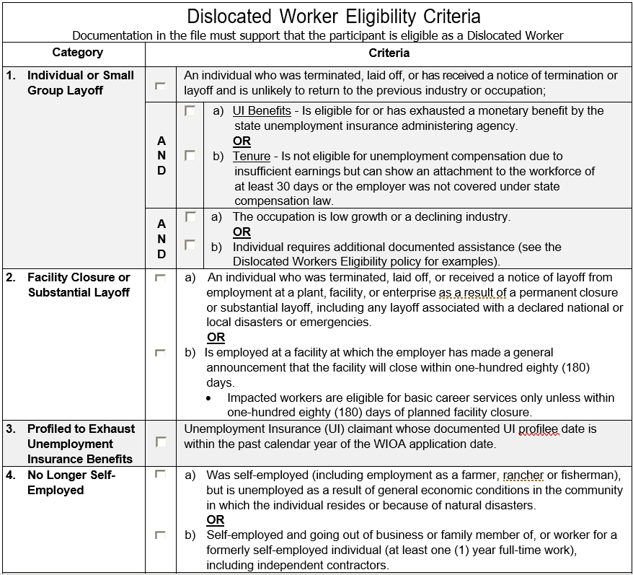
Dislocated Worker Eligibility Checklist
As part of the OET Dislocated Worker Eligibility Policy, under Attachment “C”, is a Dislocated Worker Eligibility checklist that was added
This checklist breaks down in a truncated wording the six (6) different Dislocated Worker eligibility criteria

Slide 11
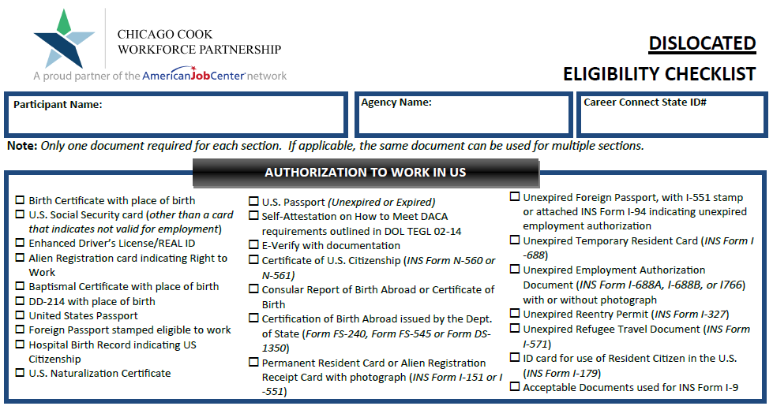
Dislocated Worker in Career Connect
In Career Connect the Dislocated Worker categories are identified different than they are in the WIOA Legislation, and in DCEO OET Dislocated Worker Policy
The current Chicago Cook Workforce Partnership Dislocated Worker Eligibility Checklist (March 2022) should always be used when working with a Dislocated Worker client

Slide 12
Dislocated Worker Categories in Career Connect
Within Career Connect the traditional Dislocated Worker Eligibility are broken down under eight (8) different categories
We will be discussing each of these eight categories in depth during this PowerPoint while tying in how those categories also fall in line with the Federal and State Dislocated Worker criteria
As previously mentioned, the portion of Dislocated Worker Eligibility under UI Profilee are not currently captured in Career Connect, so we will address how any UI profilee should still be able to have their Dislocated Worker eligibility completed in Career Connect

Slide 13
Dislocated Worker Eligibility
Before we get into the different categories of Dislocated Worker eligibility, there are some key terms that must be understood related to Dislocated Worker eligibility:
Under-Employed
Self-Sustaining Employment
Intervening Employment

Slide 14
Under-Employed
You will notice that the term Under-Employed is included as part of various WIOA Dislocated Worker Eligibility criteria
Under WIOA, Under-Employed is defined as an individual who is working part-time but desires full-time employment, or who is working in employment not commensurate with the individual’s demonstrated level of educational attainment

Slide 15
Under-Employed
TEGL 19-16 - Guidance on Services Provided through Adult and Dislocated Worker Programs also states that if an individual is working full-time but is on public assistance (Food Stamps, Cash Welfare, Medical Card, etc.), then they should also be considered under-employed

Slide 16
Under Employed
TEGL 19-16 – provided additional criteria for Under-employed:
Individuals who meet WIOA Low-Income criteria but are working full-time are considered under-employed
Individuals who are employed, but whose current job’s earnings are not sufficient compared to their previous job’s earnings from their previous employment
Similar, LWIA’s local policy on self-sufficiency criteria for a Dislocated Worker (DW) Client can be based on the individual finding employment equal to or greater than a percentage of a client’s dislocation lay-off wage

Slide 17
Self-Sustaining Employment
Self-Sustaining Employment is a job, that meets a LWIA’s definition for self-sufficiency
Under the Dislocated Worker title, as mentioned previously in this presentation, each LWIA has the latitude to define self-sufficient employment based on a percentage of a dislocation wage

Slide 18
LWIA 7 Self-Sufficiency Criteria
LWIA 7 – Economic Self-sufficiency Level Policy, states for a Dislocated Worker, the criteria is “for a client to obtain comparable to or higher wages than from the previous employment.”
As an example, if a client had made $50,000 per year at their dislocation job, for this “example” client to meet the LWIA 7 Local Policy for self-sufficiency, the client would need to obtain employment making $50,000 or more each year in order to be considered self-sufficient

Slide 19
Intervening Employment
Using the example on the previous slide of a LWIA 7 self-sufficiency criteria for a Dislocated Worker was for a client to obtain comparable to or higher wages than from the previous employment
If a client would obtain employment making less than their original dislocation wage, then that new employment would be considered “intervening employment”

Slide 20
Taking those things into Consideration
To tie everything together on these topics; if a client had “intervening employment”, they would also be considered “under-unemployed”
The client could still be considered for eligibility under the Dislocated Worker program using the original Dislocation Job, while working at the “intervening employment” due to being “under-employed”
Lastly, a client would be working in “intervening employment” at any job until they obtain “self-sustaining employment”

Slide 21
Dislocated Worker Eligibility
Now that we have those terms covered, let us get into the specifics of WIOA Dislocated Worker eligibility
As mentioned earlier, based on the State’s Dislocated Worker Policy, an individual could meet WIOA Dislocated Worker eligibility under six different categories, and each category has different eligibility criteria with significantly different documentation requirements

Slide 22
Dislocated Worker Eligibility
Under the new Dislocated Worker Policy Chapter 5 Section 3,that was issued on May 12th, 2023 there are six (6) different ways an individual could meet WIOA Dislocated Worker eligibility and each criteria is significantly different:
Unlikely to Return to Previous Industry or Occupation
Plant Closure or Substantial Layoff
UI Profilee
No Longer Self-Employed
Displaced Homemaker
Spouse of a member of the Armed Forces on active duty

Slide 23
Dislocated Worker in Career Connect
Currently in Career Connect nor on the Partnership Dislocated Worker Eligibility Checklist, is there standalone Dislocated Worker Eligibility for the Dislocated Worker criteria of “UI Profilee”
It should be noted, that any individual that gets profiled by Illinois Department of Employment Security (IDES), that would be eligible under “UI Profilee”, should meet current Career Connect Category 1 eligibility criteria
Note: More information about how a UI profilee can meet eligibility in Career Connect later in the presentation.

Slide 24
Dislocated Worker Eligibility
Out of the six different ways an individual could be determined eligible under Dislocated Worker criteria as laid out in the DCEO Dislocated Worker Eligibility Policy, by far, the most complex criteria is under “Unlikely to Return to Previous Industry or Occupation” – We will just call this “Unlikely to Return”
“Unlikely to Return” has layered eligibility criteria, meaning there are several factors that will determine if an individual meets this criteria; the next several slides will cover this very layered criteria

Slide 25
Unlikely To Return
First as listed in WIOA ePolicy Chapter 5.3 Dislocated Worker Eligibility - paragraph I.1.a.1) - The individual: 1) Has been terminated or laid off or has received notice of employment termination or layoff; this would include an individual who has separated from or has an impending separation from the Armed Forces; and

Slide 26
Unlikely To Return
This individual that has been terminated, laid off, or has received notice of employment termination or layoff; must as listed in WIOA ePolicy Chapter 5.3 Dislocated Worker Eligibility - paragraph I.1.a.2).a):
Is eligible for or has exhausted entitlement to unemployment compensation as documented in one of the following ways;
Unemployment Insurance Benefits: The classification of persons as eligible for unemployment compensation is limited to those who have been determined eligible to receive a monetary benefit by the state unemployment insurance administering agency, or who have been determined by the state unemployment administering agency to have exhausted their benefits; OR

Slide 27
Unlikely To Return
From the previous slide, in layman’s terms, to meet this portion of the criteria under “Unlikely to Return,” an individual who had worked at a job where the employer had paid into Unemployment Insurance (UI) on behalf of the client, the client must be eligible to draw a monetary UI benefit or has exhausted the monetary UI benefit

Slide 28
Unemployment Insurance (UI)
Traditional UI payments are received when an individual loses their job, where the employer of record had been paying into the UI system on behalf of the individual
When an individual applies for UI, if the employer does not dispute the UI claim, the individual can draw the UI benefit while looking for new employment

Slide 29
Unemployment Insurance (UI)
In the past, there was a lot of information about the different UI payments
Pandemic Unemployment Assistance (PUA) program was a program during the COVID-19 Crisis, which provided UI benefits for many individuals who had been determined ineligible for traditional unemployment benefits
Self-employed and independent contractor employees are probably the two most well-known groups of individuals who received PUA

Slide 30
Unemployment Insurance (UI)
Regardless if an individual receives or has received traditional UI benefits or PUA benefits, is receiving or eligible to receive a monetary benefit but is not currently drawing, or has exhausted either traditional UI or PUA, they will meet the criteria tied to UI under the eligibility for “Unlikely to Return” criteria

Slide 31
Additional Feedback on UI
Additionally, regardless if the individual was fired, quit, or laid off, if determined eligible to draw a monetary UI benefit (either traditional or PUA) or has exhausted their monetary UI benefit (either traditional or PUA), the criteria tied to being terminated or laid off is met, and the criteria tied to UI would be met

Slide 32
PUA Ended in September 2021
In September 2021, Pandemic Unemployment Assistance (PUA) ended. There were questions about how a client on PUA when the program ended should be recorded in their WIOA application regarding UI Status
Based on communication with our Policy Unit, after coordination with Illinois Department of Employment Security (IDES), based on UI Law, if an individual was drawing PUA when the program ended, (even if that individual still had a balance remaining when the PUA program ended,) the individual should be considered to have “Exhausted” their UI benefits

Slide 33
OET WIOA COVID Q&A

Slide 34
PUA Guidance from OET

Slide 35
Recent Inquiry – Notified of Impending Layoff and UI
In a recent virtual training on WIOA Dislocated Worker Eligibility, there was an excellent question about an individual who had recently been notified of a lay-off (that was not part of a closure or substantial layoff), for an individual that is working at a job where the employer had paid into Unemployment Insurance on behalf of the individual, how could that individual meet the criteria that states:
Is eligible for or has exhausted entitlement to unemployment compensation as documented in one of the following ways; Unemployment Insurance Benefits:
The classification of persons as eligible for unemployment compensation is limited to those who have been determined eligible to receive a monetary benefit by the state unemployment insurance administering agency, or who have been determined by the state unemployment administering agency to have exhausted their benefits; OR

Slide 36
Guidance on Notified of Impending Lay-off and UI
Working with our OET Policy Unit and Illinois Department of Employment Security (IDES) staff, the following guidance will be included in an update to the OET WIOA Dislocated Worker Policy Chapter 5 Section 3:
For those who have been notified of an upcoming layoff and will not have applied for UI benefits, to meet the criteria around UI, the individual must have earned at least $2,000 in at least two (2) of the last four (4) calendar quarters which should be supported by either an IBIS document or the client’s pay records. In those instances, the correct response to the Career Connect application question of “UI Status:” would be “Eligible, But Not Receiving Benefits”.

Slide 37
Dislocated Worker Eligibility
To meet this first portion of the criteria under “Unlikely to Return”, regardless if the prospective WIOA client is receiving traditional Unemployment Insurance (UI) or Pandemic Unemployment Assistance (PUA), or if they had exhausted traditional UI or PUA, they would meet this part of the criteria
Under Career Connect, this portion of Unlikely to Return to Previous Industry or Occupation falls under Category 1

Slide 38
Category 1 in Career Connect
In Career Connect – This first portion of the criteria under “Unlikely to Return” to Previous Industry or Occupation where a client is eligible for or has exhausted UI is broken out under Category 1:

Slide 39
Unlikely to Return
To recap, the initial eligibility for “Unlikely to Return to Previous Industry or Occupation” due to being eligible for or exhausted UI (which is Category 1 in Career Connect)
In addition, there is an alternative to UI for individuals who worked for an employer who had not paid into UI on their behalf; this is known as “Tenure”
Additionally “Tenure” could be awarded if a client worked at least 30 days and has insufficient earning to draw a monetary UI benefit
The details around “Tenure” will be covered on the next several slides:

Slide 40
Unlikely to Return
This individual that has been terminated or laid off or has received notice of employment termination or layoff; and as listed WIOA ePolicy Chapter 5.3 Dislocated Worker Eligibility - paragraphs I.1.a.2.b)
Tenure = has been employed for a duration sufficient to demonstrate attachment to the workforce (meaning the individual must have at least thirty (30) days of employment in the industry or occupation from which he/she was dislocated) but is not eligible for unemployment compensation due to insufficient earnings or having performed services for an employer that were not covered under a state unemployment compensation law;
NOTE: In the previous WIOA Dislocated Worker Eligibility Policy, the time to meet the “Tenure” criteria had been six (6) months in the industry or occupation, and that time frame has now been shrunken down to thirty (30) days in the 5-12-23 DW Eligibility Policy

Slide 41
Tenure Alternative to UI
“Tenure” is for an individual who worked at a job (or in the industry) for at least 30 days, where the employer did not pay into the UI system on behalf of the employee.
OR “Tenure” is for an individual who worked full-time at their dislocation job (or in the industry) for at least 30 days and had insufficient wages to draw a monetary UI benefit.

Slide 42
Further Details about Tenure
Based on recent guidance provided by IDES to our Policy Unit, for an individual to be eligible to draw a monetary UI benefit, the person must have earned at least $2,000 in at least two (2) of the last four (4) calendar quarters which should be supported by either an IBIS document or the client's pay records
If an individual has worked full-time at their dislocation job for at least 30 days but does not meet the above criteria (due to insufficient earnings), then that individual would meet the alternative criteria to UI known as “Tenure”

Slide 43
Tenure – Military Separation
Often people who separate from the armed forces after their enlistment (discharged from active duty) are not eligible for UI. If that is the case with someone you are working with, Illinois Department of Employment Security has given guidance that those individuals would meet “Tenure” if they had served at least 30 days in the armed forces and are not eligible for UI

Slide 44
Examples of “Tenure” Jobs
Some examples of jobs not covered under the state unemployment compensation law:
Church or religious organization
Railroad
Insurance agent
Agricultural labor
Domestic Service
Family Business
Many of these jobs did receive PUA benefits during COVID; from my knowledge the PUA ended in September 2021 so would only be relevant for individuals who have not had self-sustaining employment since September 2021

Slide 45
Category 2 in Career Connect
In Career Connect – This next portion of the criteria under Unlikely to Return to Previous Industry or Occupation criteria is broken out under Category 2
This part of the eligibility are for individuals who worked at a job that did not pay into the Unemployment system on behalf of the client, or if the client had worked at the job at least 30 days but had insufficient wages to draw a monetary benefit
This is known as “Tenure” the alternative to UI

Slide 46
Category 2 in Career Connect
The details in Career Connect for Category 2 are as follows:

Slide 47
Unlikely to Return Criteria
It is very important to understand that under the criteria of “Unlikely to Return”, if an individual is laid off (or fired, quit, etc.) from a job where the employer had paid into the UI system on behalf of the individual, and the individual has earned sufficient wages to draw UI benefit, but the individual is/has been denied UI benefits, the individual cannot be determined eligible under the Dislocated Worker criteria of “Unlikely to Return”.

Slide 48
Career Connect Cat 1 & 2
To reiterate from the previous slide, and to make it relevant for Career Connect Categories 1 and 2, if an individual had worked at a job where the employer had paid into UI on their behalf, and was denied to draw a monetary benefit, (unless it was insufficient wages) you cannot make the client eligible under the dislocated worker criteria of either Category 1. or Category 2. in Career Connect
There is no exception to the above paragraph.

Slide 49
Unlikely to Return Criteria
Now if a client has met the first portions of the Unlikely to Return criteria of being eligible for or exhausted UI (either traditional UI or PUA) or they met the alternative to UI called “Tenure”; the next layer of eligibility is:
WIOA ePolicy Chapter 5.3 Dislocated Worker Eligibility - paragraphs I.1.a.3.)a)i):
This individual has been laid off or terminated from a low growth industry, defined by a North American Industrial Classification System (NAICS) code category with less than the statewide average growth rate; and/or

Slide 50
Unlikely to Return Criteria
Or, if the client was not from a declining industry, they could also be determined “Unlikely to Return” if the dislocation job was from a “Low Growth Occupation”. Below is the wording from the Policy:
WIOA ePolicy Chapter 5.3 Dislocated Worker Eligibility - paragraph I.1.a.3.)a)ii)
This individual has been laid off or terminated from a low growth occupation, defined as any O*Net Codes category with an average annual employment growth rate of less than the statewide average growth rate for all occupations;

Slide 51
Dislocation Job
Meaning the clients dislocation job must be from either a declining industry and/or the low growth occupation which would be recorded on the clients application in Career Connect
Which makes sense if you think about it, in instances where an individual had been dislocated from a job that is not from a low growth occupation or a declining industry, it would seem the individual should be able to obtain new employment in either that same industry or occupation?

Slide 52
Unlikely to Return Criteria
However, in instances where a client’s dislocation job was not from a declining industry, nor was the dislocation job from a low growth occupation; if the Career Planner can justify in their assessment why an individual is unable to obtain employment in their previous industry or occupation, then it would be appropriate to check “Yes” to the question of “Require Additional Assistance”
It is important to understand the details of this criteria as explained in the next slides

Slide 53
Unlikely to Return Criteria
See the criteria outlined in WIOA ePolicy Chapter 5.3 Dislocated Worker Eligibility - paragraph I.1.a.3)b) – “Require Additional Assistance” can be used to support the remaining criteria of “Unlikely to Return”
Really should only be concerned with “Require Additional Assistance” if the dislocation job is not from a low growth occupation and/or a declining industry;
The individual requires additional assistance. After an assessment of education, skills, and work experience has been determined by the Title IB entity to “Require Additional Assistance” to qualify for any available openings in the industry or occupation from which the person was laid off, or to obtain employment in another occupation. Such determination must be documented in the person’s case file.

Slide 54
Requires Additional Assistance
Examples of requiring additional assistance laid out in Dislocated Worker Policy under section I.1.a.3)b)i) - include, but are not limited to, the following:
An individual who meets the long-term unemployed criteria (unemployed for twenty-seven (27) or more consecutive weeks);
The individual is a separating or separated member of the U.S. Armed Forces;
The individual has a history of involvement at any stage with the criminal justice system (justice-touched individual);
The individual is likely to enter a new job that is different structurally or organizationally than their previous job;
The individual is likely to enter a new job with lower seniority compared to their previous position;
The individual has a gap in employment that decreases their chances of returning to the same level of occupation or type of job, including justice-touched individuals;
There are limited employment opportunities in the occupation or industry within the local area;
There is an excess number of workers with similar skill sets and experience in the local area;
The individual has out-of-date or inadequate skills;
The individual has adequate skills, but lacks a credential required by most employers;
The individual has a barrier to employment such as a disability, medical condition, or legal issues that could prevent a return to employment in the same industry or occupation; or
An unsuccessful job search suggests the individual is unlikely to regain employment in their previous occupation or industry.

Slide 55
Unlikely to Return Criteria
It is important to understand this alternative criteria under “Unlikely to Return” is related to the questions of “Required additional assistance to regain employment,” would only be needed if the client’s dislocation job is not from a declining industry or low growth occupation
Most dislocation jobs are from either a declining industry, low growth occupation, or both

Slide 56
Unlikely to Return Criteria
To recap, for any client to meet dislocated worker eligibility criteria for “Unlikely to Return” they must first be eligible to draw a monetary UI benefit or exhausted UI or meet the alternative to UI called “Tenure”. Then the individual must also meet one or more of the following:
Dislocation job must be from a declining industry or a low growth occupation
The client “Requires Additional Assistance”, which must be justified in the case note as to why the client was laid off from a job that was not from a declining industry or a low growth occupation
The updated Dislocated Worker Policy Chapter 5 Section 3., lists many great examples that have been added

Slide 57
Unlikely to Return Criteria
This wraps up the dislocated worker eligibility criteria for “Unlikely to Return to Previous Industry or Occupation”
If you understand the in’s and out’s of “Unlikely to Return” eligibility, the rest of WIOA Dislocated Worker Eligibility should be easy

Slide 58
Career Connect DW Categories
What is the difference between Category 1. and Category 2., in Career Connect?

Slide 59
Career Connect DW Categories
In Career Connect, Category 1., requires the client must be eligible or exhausted UI Status; Category 2., requires the client must meet the alternative to UI known as the “Tenure” criteria
All the other eligibility is the same

Slide 60
WIOA Dislocated Worker Eligibility
Plant Closure or Substantial Lay-off criteria outlined in WIOA ePolicy Chapter 5.3 Dislocated Worker Eligibility paragraphs I.2.a.1)2)3)
Under Career Connect Plant Closure or Substantial Layoff are broken out into Category 3. or 4.

Slide 61
Plant Closure or Substantial Layoff
An individual must have been terminated or laid off, or has received notice of termination or layoff from employment due to a permanent closure of, or a substantial layoff at a plant, facility or enterprise; OR

Slide 62
Guidance on Substantial Lay-off
One of the most exciting updates in the DCEO OET Policy Chapter 5 Section 3 – Dislocated Worker Eligibility that was issued on updated policy guidance is around the broadening of what can be considered a “Substantial Lay-off”!
I feel this updated guidance is a true game changer and can assist in instances where in the past, someone might not have been eligible as a Dislocated Worker, but if an individual meets this updated guidance, it will make them eligible as a Dislocated Worker under “Substantial Layoff”.

Slide 63
Substantial Layoff Guidance
Under WIOA ePolicy Chapter 5.3 Dislocated Worker Eligibility Policy, for additional guidance about “Substantial Layoff” under paragraphs I.2.a.1)a)i)ii)iii) states:
Substantial layoff includes, but is not limited to, the following:
Any layoffs resulting from Federal, State, or local disasters or emergencies (e.g., flood, tornado, fire, COVID, etc.);
Documented State or Local Rapid Response layoff in the Illinois Employment Business System (IEBS); or
Layoffs from sectors and occupations that are substantial or significant to the regional or local workforce or economy as identified by the local workforce innovation board (LWIB).

Slide 64
Looking More In-depth
Under WIOA ePolicy Chapter 5.3 Dislocated Worker Eligibility Policy, for additional guidance about “Substantial Layoff” under paragraphs I.2.a.1)a)i)ii)iii) states:
Substantial layoff includes, but is not limited to, the following:
Any layoffs resulting from Federal, State, or local disasters or emergencies (e.g., flood, tornado, fire, COVID, etc.);

Slide 65
Updated Substantial Layoff Guidance
In layman’s terms, IF the dislocation for any individual can be tied to either COVID; Flood; Tornado; Fire; etc., then when recording the “Layoff Reason”, the appropriate response would be either “Substantial Layoff” or “Plant Closure” (whichever is correct.)
To clarify, even if the layoff was just one or two persons, if the layoff can be tied to any Local, State or National Emergency, (which COVID does meet criteria of a National Emergency), then it is correct to record the layoff reason as “Substantial Layoff”.

Slide 66
What Does Bullet “iii” Really Mean ?
In the updated Dislocated Worker Policy, as shown on the previous slide under bullet “iii”, what does, “Layoffs from sectors and occupations that are substantial or significant to the regional or local workforce or economy as identified by the local workforce innovation board (LWIB).” mean?

Slide 67
Feedback from Regional Managers
Response from Regional Program Managers for DCEO OET: Substantial sectors and occupations should come from the Local and Regional Plan documents. If the occupation/sector is not listed in the local plan, but there are other extenuating factors that the board believes will impact the local economy, they can determine as circumstances warrant, to include those layoffs as significant to the local economy. The circumstances should be defined in the local policy along with a statement from the LWIB as supporting documentation for eligibility purposes.

Slide 68
Example Provided
A company closes or has a mass layoff, and it impacts other employers that do business with that company
Fiat Chrysler had a layoff of their second shift, which impacted five other employers who were Tier 1 suppliers in the region.
A recent Owens-Brockway Glass Containers layoff event in Streator IL is a manufacturing layoff impacting 161 people.
Manufacturing is included in the local plan, but the number of layoffs at Owens is significant enough for the local economy, that there may be a ripple effect into nearby local businesses that may be in sectors not included in the local plan, but still considered part of a “significant event” for the local economy.

Slide 69
Example of an LWIA Local Policy
Each LWIA has the option to update/develop their own Local Dislocated Worker Policy where they can identify substantial or significant sectors or occupations.
Doing this, the Local Dislocated Worker Policy must be approved by the Local Workforce Innovation Board.
Down in Southern Illinois, LWIA 25 was very proactive after the State’s guidance was issued to allow broadening what could be considered a “Substantial Layoff”.
The next few slides will demonstrate the current LWIA 25 Policy as an example of what could be utilized to broaden WOIA Dislocated Worker eligibility criteria.

Slide 70
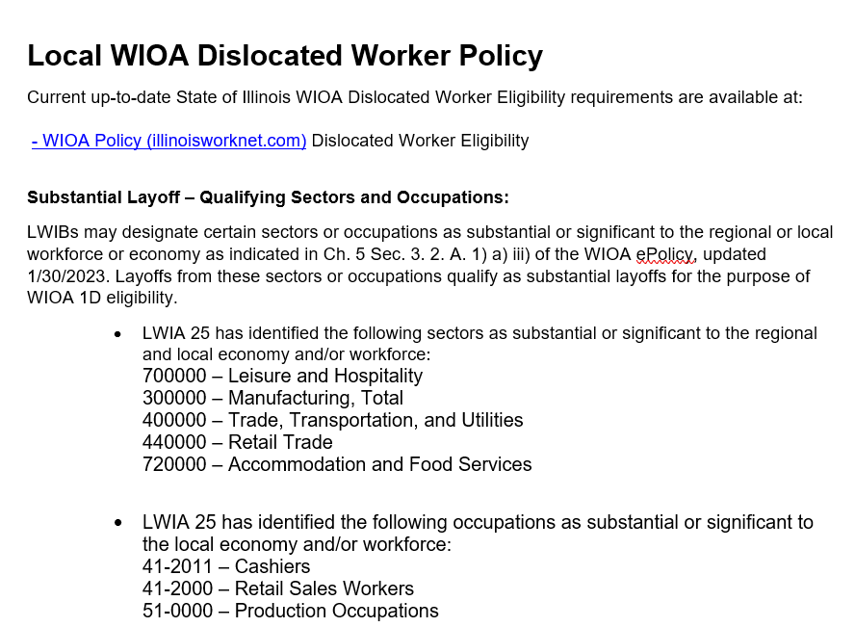
Example LWIA 25 Guidance
LWIA 25 has been very proactive and developed Local Policy Guidance around identifying substantial or significant sectors or occupations.
On the adjacent screen print is their Local Policy:

Slide 71
LWIA 25 Local Policy
To tie this together, the LWIA 25 Policy allows any individual who had been dislocated from those industries and/or occupations identified in their Local Policy, to characterize the Dislocation Job as a “Substantial Layoff”.
So even in cases where the dislocation from the specific industry and/or occupation would not meet traditional criteria around “Substantial Layoff” due to the approved Local Policy, it would meet the criteria.
However, this is only allowed if an LWIA creates a similar Local Policy as was demonstrated in the previous slide, and then the LWIB approves the Local Policy.

Slide 72
Example of an LWIA Local Policy
Keep in mind, those last few slides were just an example of the current LWIA 25 Dislocated Worker Policy and has nothing to do with your LWIA 7 Dislocated Worker Policy/guidance.
Currently, it is my understanding that LWIA 7 is considering options on how they intend to update their own Local Dislocated Worker Policy around defining specific industries or occupations that are considered essential to LWIA 7

Slide 73
Substantial Layoff Details
Often there are questions about what is a “Substantial Layoff”?
As discussed, the updated Dislocated Worker Policy provided guidance that broadened criteria around “substantial layoff”.
In addition, a “substantial layoff” could be tied to 50% of employees but could be broadened depending on the situation.
As an example, if a company was running three shifts, but closed an entire shift, that might only equal 1/3 of employees but could easily be justified as a “Substantial Layoff”.
Or, say a company has a small sales force of six sales staff, and they layoff three of the sales staff, that would be half of the sales force and could be considered a “substantial layoff”.
If you have questions about whether a client meets the criteria as a “Substantial Layoff”, reach out to your Regional Manager or Program Coordinator.
If still not sure, reach out to your OET Rapid Response team.

Slide 74
Plant Closure or Substantial Layoff
Within Career Connect, the logic for determining if a client meets the criteria as a Dislocated Worker under Plant Closure or Substantial Layoff – is based on the dislocation job from the “Edit Job” screen:
Specifically determined based on how the “Lay-off Reason” is populated
If either “Plant Closure” or “Substantial Layoff” is the “Lay-off Reason”, Career Connect logic will make the client eligible as a Dislocated Worker under Plant Closure or Substantial Layoff

Slide 75
Plant Closure or Substantial Layoff
An individual must have been terminated or laid off, or has received notice of termination or layoff from employment due to a permanent closure of, or a substantial layoff at a plant, facility or enterprise; OR
Is employed at a facility in which the employer has made a general announcement that the facility will close within 180 days;

Slide 76
Plant Closure or Substantial Layoff in Career Connect
Under Career Connect, Plant Closure or Substantial Layoff is recorded under Category 3. or 4.:
Category 3., is for clients who have already been laid off due to Plant Closure or Substantial Layoff
Category 4., is for clients who have been notified via a public notice of an upcoming layoff due to Plant Closure or Substantial Layoff

Slide 77
Category 3 in Career Connect
Under Category 3, the individual has already been laid off due to a plant closure or a substantial layoff:

Slide 78
Category 4 in Career Connect
Category 4, person has been notified of impending layoff/closure due to a public notice, but are still working:

Slide 79
Categories 3 & 4 in Career Connect
The only difference between Category 3. & 4. eligibility in Career Connect is, for Category 4. the person is still employed, and the only way he/she knows about a layoff is through some sort of public notice of the upcoming closure/layoff

Slide 80
Plant Closure or Substantial Layoff
Something to understand about Plant Closure/Substantial Layoff, there is no additional criteria tied to UI status or “Tenure” criteria; nor is there any criteria tied to if the dislocation job is from a declining industry or low growth occupation; or if the individual requires additional assistance to regain employment

Slide 81
Plant Closure or Substantial Layoff
One of the easiest ways to qualify your clients is under the Dislocated Worker criteria of Plant Closure or Substantial Layoff and should be used any time the client meets the criteria

Slide 82
WIOA Dislocated Worker Eligibility
Profiled to Exhaust Unemployment Insurance Benefits criteria outlined in WIOA ePolicy Chapter 5.3 Dislocated Worker Eligibility paragraphs I.3.a.1)2)3).
This is the newest Dislocated Worker eligibility criteria that has been added and is also known as “UI Profilee”
In this presentation, we are going to go much deeper in explaining details about the newest Dislocated Worker “UI Profilee” criteria

Slide 83
UI Profilee
The Dislocated Worker Eligibility Policy guidance around UI Profilee states:
The individual is profiled and referred Unemployment Insurance (UI) claimant whose UI profile date is within the past calendar year of the WIOA application date;
The state has determined as allowed per 680.130(b)(3) of the WIOA legislation, that UI profiles are eligible dislocated workers with the definition of dislocated worker in WIOA Section 3(15)
In such instances, no further documentation will be needed to establish the “Unlikely to Return to a Previous Industry or Occupation” criteria of WIOA section 3(15)(A)(iii)
As a result, acceptance of UI Profiling data to prove eligibility for meeting the requirements of 3(15) is the only standard. General eligibility will still apply

Slide 84
UI Profilee in Career Connect
As stated earlier in this presentation, currently Career Connect does not have any way to identify if an individual has been profiled by Illinois Department of Employment Security (IDES), however, any client that has been profiled by IDES would be Category 1 in Career Connect:

Slide 85
UI Profilee and Category 1
For an individual to meet Category 1, the individual had to be laid off, eligible for or exhausted UI and either from a declining industry or low growth occupation, these are some of the different criteria IDES considers prior to deciding who they are going to Profile
Any client that IDES has profiled should also meet criteria under Category 1 in Career Connect

Slide 86
No Longer Self-Employed
Criteria for Formerly Self-Employed is outlined in WIOA ePolicy Chapter 5.3 Dislocated Worker Eligibility paragraphs I.4.a.1)2).
Must be the individual's primary job
Formerly self-employed but no longer employed requires something showing the business closed or is closing due to:
General economic conditions
Flood or other natural disasters
Going out of business and has evidence of conditions to support business failure

Slide 87
No Longer Self Employed in Career Connect
Under Category 5, the individual had previously owned their business, but the business has closed or is in the process of going out of business:

Slide 88
Displaced Homemaker
Criteria for Displaced Homemaker is addressed in WIOA ePolicy Chapter 5.3 Dislocated Worker Eligibility paragraphs I.5.a.b.

Slide 89
Displaced Homemaker in Career Connect
Within Career Connect, an individual must meet the definition of a Displaced and if they do, they will meet Dislocated Worker eligibility criteria under Category 6:

Slide 90
Displaced Homemaker
For an individual to meet the eligibility criteria under “Dislocated Worker - Displaced Homemaker” they must have been providing unpaid services to family members and who:
Has been dependent on the income of another family member but is no longer supported by that income; and
Is unemployed or is under-employed and having difficulty in obtaining or upgrading employment

Slide 91
Displaced Homemaker
One point to note, under the new WIOA definition (see glossary of terms) for “Displaced Homemaker” there has been additional wording added to the definition of the “Displaced Homemaker” where it speaks about the dependent spouse of a member of the Armed Forces so that is available. However, the wording is a bit awkward and appears to duplicate the new criteria of Spouse of an Active-Duty Service Member
I would utilize the new WIOA Dislocated Worker criteria of Spouse of Active-Duty Service that we will discuss in a few moments for those individuals

Slide 92
Displaced Homemaker
The eligibility criteria is captured on the Dislocated Worker Characteristics screen. If the question “Displaced Homemaker” is populated with a “Yes, " then the internal logic within Career Connect will make the client eligible under displaced homemaker criteria

Slide 93
Displaced Homemaker Examples
Possible “Displaced Homemaker” eligibility criteria:
Unemployed or under-employed spouse who gets divorced/separated and cannot afford to get a divorce from the primary earner in the family
Unemployed or under-employed whose spouse was the primary earner and passed away
Unemployed or under-employed spouse where the primary earner in the family loses their job

Slide 94
Displaced Homemaker
For the documentation to support the claim of “Displaced Homemaker” – it depends on which criteria of eligibility the client meets as a “Displaced Homemaker”:
Typically, you will need the client’s work history showing either unemployed or under-employed. Then based on the scenario, you would need either a court order, death certificate, self-attestation for marital status for those who cannot afford a divorce, or a layoff letter of the spouse

Slide 95
Spouse of Active-Duty Service Member
Criteria for Spouse of a member of the Armed Forces on Active Duty is addressed in WIOA ePolicy Chapter 5.3 Dislocated Worker Eligibility paragraphs I.6.a.1).2)
Spouse of Active Duty Service Member are recorded under Category 7. & 8. in Career Connect

Slide 96
Spouse of Active-Duty Service Member
For an individual to meet the eligibility criteria under “Dislocated Worker – Spouse of Active-Duty Service Member” they must meet one of the following criteria:
Has experienced a loss of employment as a direct result of relocation to accommodate a permanent change in duty station; OR,
Is unemployed or under-employed and experiencing difficulty in obtaining or upgrading employment

Slide 97
Spouse of Active-Duty Service Member
To qualify as a Dislocated Worker – Spouse of Active-Duty Service member, then the spouse must have lost their job due to relocation from a transfer or duty station; or if the spouse is unemployed, underemployed and experiencing difficulty in obtaining or upgrading employment

Slide 98
Categories 7 & 8 in Career Connect
The distinction for Category 7. in Career Connect is that the spouse lost their job due to relocation for change of duty station of the active-duty service member spouse
Where Category 8. in Career Connect is the spouse of active-duty service member who is either unemployed or underemployed and having difficulty obtaining or upgrading employment

Slide 99
Spouse of Active-Duty Service Member
At a minimum, the documentation would include the military identification card showing the spouse of an activity duty service member, then if lost employment due to the spouse being transferred, the transfer orders along with the client’s work history
If eligibility were based on the military spouse being unemployed or underemployed and experiencing difficulty in obtaining or upgrading employment, you would need the client’s military identification card showing the spouse of an active-duty service member and the client’s work history supporting unemployed or under-employed

Slide 100
Dislocated Worker Eligibility
This concludes the various ways an individual could meet WIOA Dislocated Worker Eligibility criteria
There are six different ways an individual could meet WIOA Dislocated Worker eligibility and each criteria is significantly different
However, in Career Connect, there are eight different categories to capture the WIOA Dislocated Worker Eligibility

Slide 101
Overview of Dislocated Worker Eligibility
WIOA ePolicy Chapter 5.3 Dislocated Worker Eligibility
Unlikely to Return to Previous Industry or Occupation
Plant Closure or Substantial Layoff
UI Profilee
No Longer Self-Employed
Displaced Homemaker
Spouse of a member of the Armed Forces on active duty

Slide 102
Overview of DW Eligibility in Career Connect
Category 1 – Unlikely to Return to Previous Industry or Occupation due to receiving or exhausting UI
Category 2 - Unlikely to Return to Previous Industry or Occupation due to meeting the “Tenure” criteria
Category 3 – Plant Closure/Substantial Layoff and the client has been laid off
Category 4 – Been notified via a public notice of an upcoming layoff due to Plant Closure or Substantial Layoff
Category 5 – No Longer Self-Employed
Category 6 – Displaced Homemaker
Category 7 – Spouse of Active Duty Service Member who had to leave job when active duty spouse was transferred to a new duty station
Category 8 – Spouse of Active Duty Service Member who is unemployed or underemployed and experience difficulty obtaining or upgrading employment

Slide 103
Concludes this PowerPoint
This concludes the presentation on WIOA Dislocated Worker Eligibility
Please contact your Regional Manager or Project Coordinator for any questions

