Slide 1
WIOA Adult Eligibility
September 18th, 2023

Slide 2
Objective
The primary objective of this presentation is to inform the audience about the details around Workforce Innovation and Opportunity Act (WIOA) Adult Eligibility.

Slide 3
Federal Guidance
Workforce Innovation and Opportunity Act (WIOA) of 2014.
Training and Employment Guidance Letter (TEGL) 19-16 – Guidance on Services Provided through Adult and Dislocated Worker under WIOA – dated March 1st, 2017.
TEGL 07-20 – Implementation of Priority of Service in WIOA Adults – dated November 24th, 2020.

Slide 4
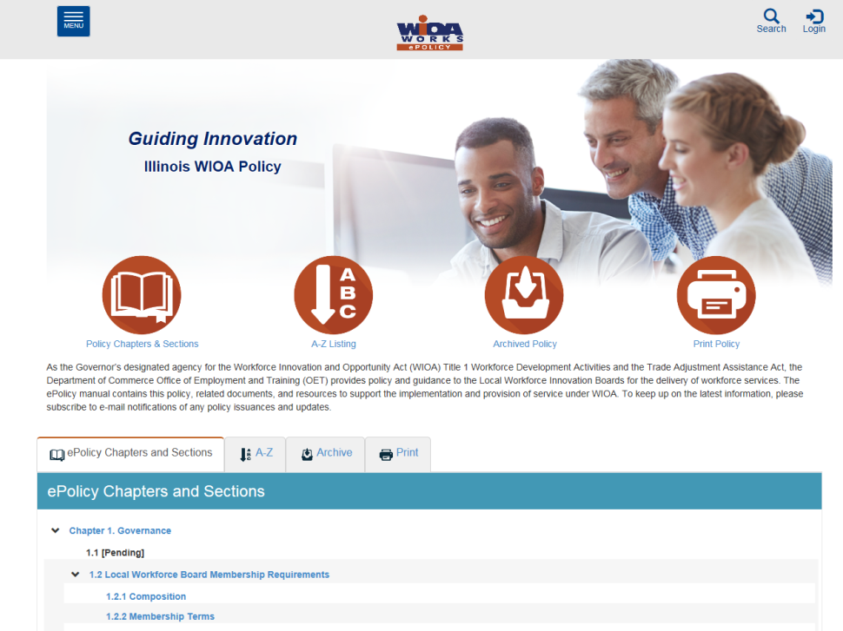
Understanding the ePolicy Manual
The Illinois Department of Commerce and Economic Opportunity, Office of Employment and Training (OET) utilizes a WIOA ePolicy portal where all current and new guidance issued by the Illinois Workforce Innovation Board (IWIB) and OET will be maintained.
Homepage: www.illinoisworknet.com/DCEOPolicies

Slide 5
State Policy Guidance
Office of Employment and Training (OET) WIOA ePolicy Chapter 5.1 – WIOA General Eligibility
OET WIOA ePolicy Chapter 5.1.1 – Compliance with Selective Service
OET WIOA ePolicy Chapter 5.2 – Adult Eligibility
OET WIOA ePolicy Chapter 5.5 – Low Income Eligibility
OET WIOA ePolicy Chapter 5.9 – Basic Skills Deficiency Assessment Requirements

Slide 6
Local Policy/Guidance
Besides the guidance in Federal and State Policies, each Local Workforce Innovation Area (LWIA) has the latitude to establish additional Local Policy Guidance.
Chicago Cook Workforce Partnership does an exceptional job conducting tailored virtual trainings/webinars and has developed a Staff Training Guide that can be accessed on the Career Connect Zen Desk: LINK: https://workforceboard.zendesk.com/hc/en-us/articles/7760807734541--WIOA-Staff-Training-Guide-Worksheet (See next slide)

Slide 7
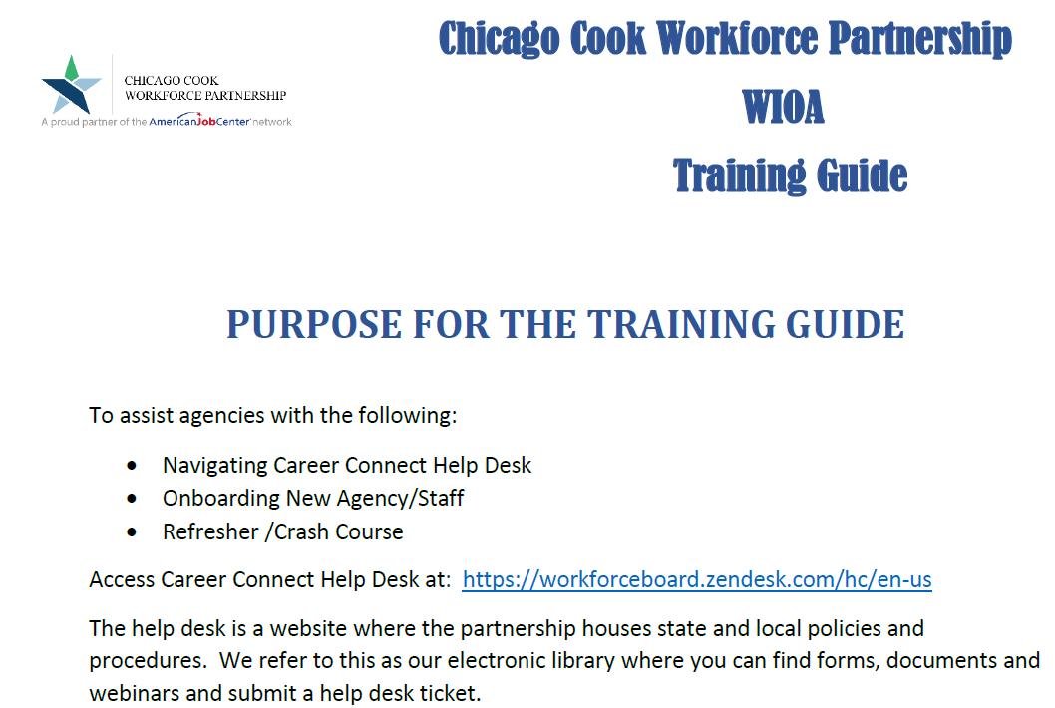
Local Policy/Guidance

Slide 8
General Eligibility; Low Income and Basic Skills Deficient
Prior to reviewing this presentation on Adult Eligibility, if you did not participate in the live presentations, it is important that you view and understand the details that were covered in the 9-14-23 presentations:
  WIOA General Eligibility – posted on Zen Desk
  WIOA Low Income – posted on Zen Desk
  WIOA Basic Skills Deficient – posted on Zen Desk

Slide 9
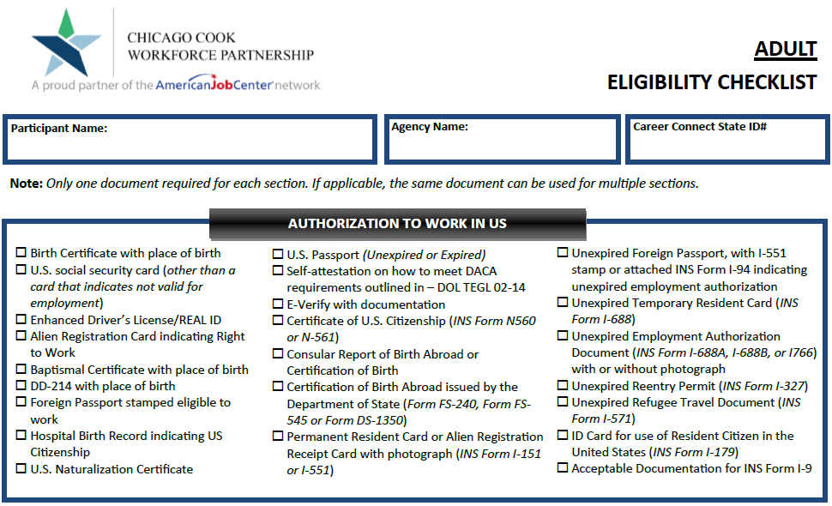
Partnership Adult Checklist

Slide 10
WIOA Adult Eligibility
WIOA ePolicy Chapter 5.2 – Adult Eligibility
  WIOA Legislation requires that an Adult be 18 years of age or older.
  Be a citizen or noncitizen authorized to work in the US; and
  Meet Military Selective Service registration requirements (individuals born male only).

Slide 11
WIOA Adult Priorities
WIOA Adult clients who meet WIOA Low-Income criteria are a priority under WIOA Legislation.
WIOA Adult clients who are determined “Basic Skills Deficient” (BSD) or are considered “English Language Learners” (ELL) are a priority under WIOA Legislation.
It is important to understand that Low-Income, BSD & ELL are equal priorities under the Adult title.

Slide 12
Veterans Priority of Service
As was addressed in the WIOA General Eligibility presentation, based on guidance in the Jobs for Veterans Act, a Veteran or Qualified Spouse of a Veteran must receive priority of service over other qualified individuals who are not a Veteran or Qualified Spouse of a Veteran.

Slide 13
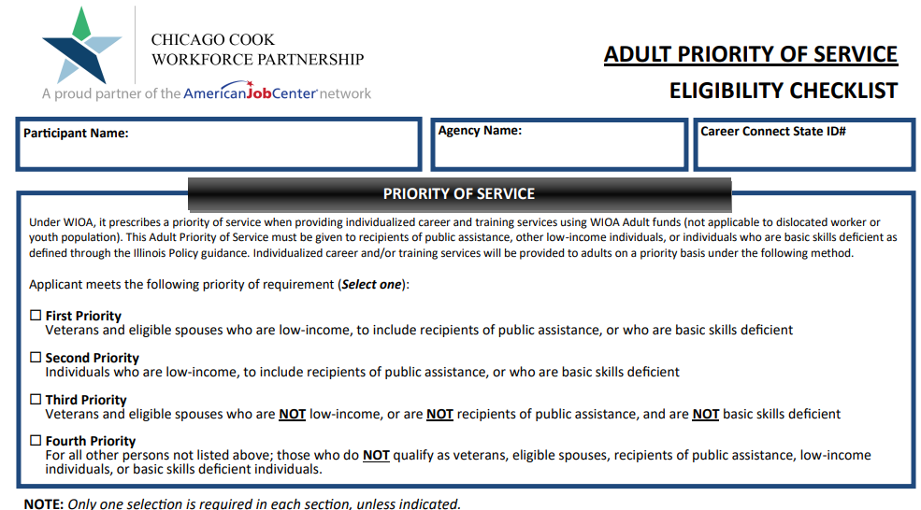
Adult Priority of Service Eligibility Checklist

Slide 14
Adult Priorities Must Be Followed at all Times
Veterans and eligible spouses who meet WIOA low-income criteria or are BSD or ELL.
Individuals who are not veterans, who meet WIOA low-income criteria, or are BSD or ELL.
Veterans or eligible spouses who do not meet WIOA low-income criteria and are not BSD or ELL.
Non-veterans who do not meet WIOA low-income criteria or BSD/ELL criteria

Slide 15
DOL TEGL 7-20
Department of Labor issued TEGL 7-20, Implementation of Priority of Service in WIOA Adults in November 2020:
  This guidance issues a threshold for each state (which in turn will be monitored down to each LWIA,) to serve at least 75% of their Adult population in one or more of the priority groups of Low-Income, Basic Skills Deficient (including English Language Learners), as well as Veterans or Qualified Spouse of a Veteran.

Slide 16
DOL TEGL 7-20 – Tracked by Exiters
Department of Labor issued TEGL 7-20, Implementation of Priority of Service in WIOA Adults in November 2020:
  Closer examination of TEGL 7-20, it was noted that DOL will be tracking this Adult Priority based on Adult Exiters in PY20 (7-1-20 – 6-30-21) to capture a baseline on how each state (and each LWIA) has been doing regarding serving Adult clients who have met the WIOA Adult Priorities outlined in the WIOA legislation.

Slide 17
PY20 Adult Exiters
Below were how the PY20 exiters numbers were reported (exited on or after 7-1-2020 through 6-30-21) - number of Adult exited clients who had met one or more of the Adult Priorities:
State-wide: 3,424 total – 3,137 who met priority = 91.6%
LWIA 7: 1,486 total – 1,344 met priority = 90.4%

Slide 18
PY21 Adult Exiters
Below were how the PY21 exiters numbers were reported (exited on or after 7-1-2021 through 6-30-22) - number of Adult exited clients who had met one or more of the Adult Priorities:
State-wide: 4,292 total – 3,925 who met priority = 91.4%
LWIA 7: 1,876 total – 1,687 met priority = 89.9%
Note: These reported PY21 Adult exiter counts were as of 11-29-2022

Slide 19
PY22 Adult Exiters
Below were how the PY22 exiters numbers were reported (exited on or after 7-1-2022 through 6-30-23) - number of Adult exited clients who had met one or more of the Adult Priorities:
State-wide: 4,004 total – 3,674 who met priority = 91.8%
LWIA 7: 1,876 total – 1,673 met priority = 89.2%
Note: These reported PY22 Adult exiter counts were as of 8-2-2023

Slide 20
DOL TEGL 7-20 – Tracked by Exiters
Department of Labor issued TEGL 7-20, Implementation of Priority of Service in WIOA Adults in November 2020:
  For those working with the Adult title, you must be aware of these priorities and ensure you are following the priorities.
  From reviewing the results over the past three Program Years, you folks are doing an excellent job with the implementation of priority of service for WIOA Adult clients.

Slide 21
WIOA Low Income
As was addressed in the WIOA Low Income presentation on 9-14-2023, there are six different ways an Adult client could meet WIOA Low Income criteria.
If a client meets any one of the six WIOA Low Income criteria, they should receive priority under the WIOA Adult title.

Slide 22
WIOA Low Income
As was addressed in the WIOA Low Income presentation, below are the six different ways an Adult client could meet WIOA Low Income criteria:
  Cash Welfare
  Food Stamps
  Homeless
  Foster Child
  Family Low-Income Determination
  Family of One Due to a Disability

Slide 23
Adult Priority Due to Low Income
If a qualified Adult client meets any one or more of the six WIOA Low-Income criteria shown on the previous slide, they should be certified under Adult Low-Income and receive priority under the WIOA Adult title.

Slide 24
Basic Skills Deficient Definition
Basic Skills Deficient (BSD) – respect to an individual—
who is a youth, that the individual has English reading, writing, or computing skills at or below the 8th grade level on a generally accepted standardized test; or
who is a youth or adult, that the individual is unable to compute or solve problems, read, write, or speak English, at a level necessary to function on the job, in the individual’s family, or in society.

Slide 25
Basic Skills Deficient
As was covered in the standalone presentation on Basic Skills Deficient (BSD), there are three different ways an Adult client could meet the WIOA Adult Priority tied to BSD:
  Scoring at or below 8th Grade Level Equivalency (GLE) on their pre-assessment math or reading tests.
  Being determined BSD due to the Basic Skills Screening Tool.
  If an Adult Client is assessed as an English Language Learner (ELL).

Slide 26
Recording Assessment Tests
An important detail that I have been asked to stress, when assessment tests are being recorded on a client in Career Connect, even though the Grade Level Equivalency (GLE) is not required field on the screen, you must record the clients accurate GLE to get proper credit for Federal Reporting.

Slide 27
Within Career Connect
Within Career Connect, on the “Barriers” screen within the application, is where the question related to Basic Skills Deficient is recorded when a client has scored at or below 8 Grade Level on their pre-assessment Math or Reading test.

Slide 28
Within Career Connect
If you have an assessment test dated on or prior to the clients WIOA application date that would support the client being BSD, you record “Yes” to the Basic Skills Deficient/Low Levels of Literacy question, then for the documentation under “verify”, the documentation would be the “Results from an Authorized Assessment Test”.

Slide 29
Why Have a Screening Tool?
An important detail to understand is; the purpose of the Basic Skills Screening Tool is a way to capture the criteria under section (B) of the WIOA Basic Skills Deficient definition, (see yellow highlighted portion directly below):
Basic Skills Deficient – with respect to an individual— (A) who is a youth, that the individual has English reading, writing, or computing skills at or below the 8th grade level on a generally accepted standardized test; or (B) who is a youth or adult, that the individual is unable to compute or solve problems, or read, write, or speak English, at a level necessary to function on the job, in the individual’s family, or in society.

Slide 30
Basic Skills Screening Tool
We will now transition to the next way a client could be determined BSD.
Based on guidance in WIOA ePolicy Chapter 5.9 Basic Skills Deficiency (BSD) Assessment Requirements, effective 5/17/2023
  Attachment “A” within this policy is a Basic Skills Screening Tool (see example on next slide.)
  If a client has a response of “No” to any of the questions on the screening tool, they will be determined BSD.

Slide 31
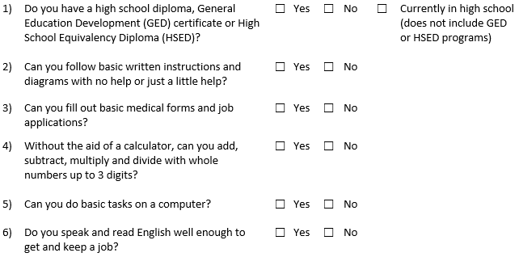
Basic Skills Screening Tool
If an individual replies “No” to any of the following questions on the screening tool, they can be determined BSD:

Slide 32
Basic Skills Screening Tool
Within Career Connect, on the “Barriers” screen within the application, is where the question has been added when a client is being determined BSD due to the new screening tool.
If any question on the screening tool is answered “No” by the client, then the question “Basic Skills Deficient/Low Levels of Literacy” on the “Barriers” screen should be answered “Yes”; (see example on next slide).

Slide 33
Basic Skills Screening Tool
Demonstrating BSD due to the screening tool in Career Connect:

Slide 34
Basic Skills Deficient
Similarly, if an individual scores at or below 8th Grade Level on either their Math or Reading Assessment test they would be determined BSD and the question “Basic Skills Deficient/Low Levels of Literacy” on the “Barriers” screen in the application in Career Connect should be answered “Yes”.
If a client is determined BSD due to both the Basic Skills Screening tool and based on assessment test(s), documentation should be in the hard copy file to support the clients complete BSD status.

Slide 35
English Language Learner
English Language Learner – when used with respect to an eligible individual, means an eligible individual who has limited ability in reading, writing, speaking, or comprehending the English language, and (A) whose native language is a language other than English; or (B) who lives in a family or community environment where a language other than English is the dominant language.

Slide 36
English Language Learner
Within Career Connect, on the “Barriers” tab within the application, is a question, “Do you primarily speak a language other than English?”
If the question is populated with a “Yes”, the client will meet the barrier as an English Language Learner (ELL). (See example on next slide.)

Slide 37
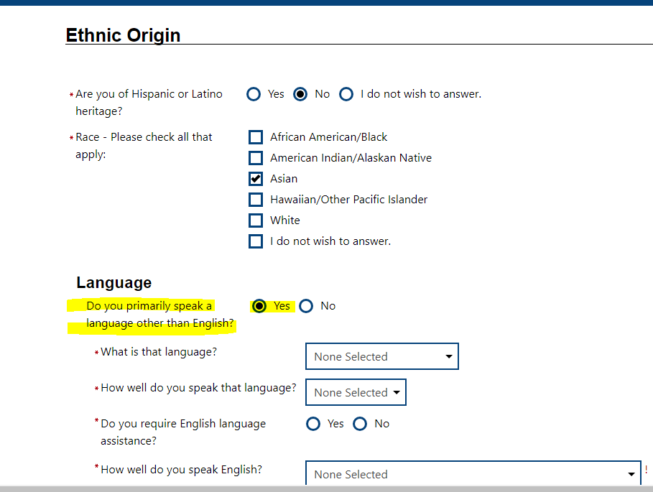
English Language Learner

Slide 38
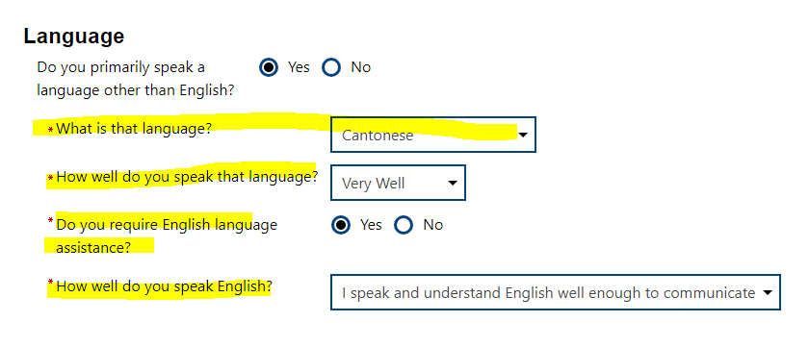
English Language Learner
In Career Connect, if a client is identified as an English Language Learner, the client must indicate a language of preference.

Slide 39
Recap Adult BSD Criteria
If an individual scores at or below 8th Grade Level on either their Math or Reading Assessment test they would be determined BSD.
An individual can be determined BSD using the Basic Skills Screening Tool.
Lastly, if an individual is assessed as an English Language Learner (ELL), they are also determined to meet BSD criteria.
LWIA 7 has an excellent Adult Priority of Service Checklist.

Slide 40
Adult Training Services
Prior to certification under “Training Services” an Adult client must have:
  Documented Assessment
  Individual Employment Plan (IEP)

Slide 41
Individual Employment Plan (IEP)
IEP - A plan developed by the participant and the Career Coach to identify the participant's employment goal, the appropriate achievement objectives, and the appropriate combination of services for the participant to achieve the employment goal, including providing information on eligible providers of training services and career pathways to attain career objectives.

Slide 42
Adult Training Services
The “Assessment” and “IEP” could be completed by either the LWIA staff (Career Coach); WIOA Core partner staff (Adult Ed., Wagner Peyser, Vocational Rehab, TANF staff); Training Provider or staff from some other agency.
  Most often the assessment and IEP will be completed by the WIOA Adult Career Coach at the LWIA.

Slide 43
Co-Enrolled Adult Client
WIOA Adult clients who meet the priority of services – (Low-Income and/or Basic Skills Deficient) could be co-enrolled with an age-appropriate Youth title or a Dislocated Worker title to break up funding of services:
  If this is done, the client cannot exit from one title until services from all titles are completed.
  If this is done, the client would fall into performance outcomes for each title that the client is registered.
Note, if an Adult client does not meet one of the Adult Priorities, but meets either Youth or Dislocated Worker criteria, they should not be served under the Adult title.

Slide 44
Overview
To recap, for overall WIOA Adult Eligibility a client must be 18 years of age or older, be legally authorized to work in the U.S. and if born a male, who was born on or after 1/1/1960, must be compliant with Selective Service requirements.
However, it is important that the priorities laid out in the OET WIOA Adult Policy are always followed, meaning:
  Veterans Priority of Service must be followed.
  Any qualified Adult who meets WIOA Low-Income criteria or is Basic Skills Deficient or is considered an English Language Learner must receive priority to eligible Adults who do not meet the priorities laid out.

Slide 45
Additional Training Opportunities
Workforce Innovation Opportunity Act (WIOA) Professional Development
The Illinois Center for Specialized Professional Support (ICSPS) assists in facilitating WIOA professional development. WIOA Professional Development webinars are available to assist one-stop operators, WIOA administrators, WIOA core partners, and other service providers. This includes weekly Workforce Wednesday Webinars, the WIOA Summit, and a variety of other professional development opportunities. Be sure to join the ICSPS email listserv at https://icsps.forms-db.com/view.php?id=149615 to receive announcements and participate in upcoming training.

Slide 46
Questions
This concludes the presentation on WIOA Adult Eligibility.
Please contact your Regional Manager or Project Coordinator for any questions.

