Slide 1


The Reentry
Navigation Initiative:
The Road Home
Partner Agency Manual
2024

Slide 2
The Reentry Navigation Initiative: The Road Home Manual is sponsored by The Office of the President of the Cook County Board of Commissioners and the Chicago Cook Workforce Partnership

Slide 3
Table of Contents
I. Program Overview.......... 3
Background
Purpose
Implementation
Program Design
Program Goal
Performance Measures
II. Business Engagement………. 9
Paid Work Experiences
On-the-Job Training
Develop quality Paid Work Experiences
Paid Training
III. Reentry Navigation………. 14
Phase I Pre-Release
Recruitment and Eligibility
Screening and Enrollment
Navigation Services
Phase II Community Based Resources
Basic Needs
Reentry
Education
Workforce Development
Placement
Phase III Retention
Retention Activities
VI. Reporting and Administration
Tracking Program Data
Reporting and Performance Management
Program and Fiscal Monitoring
Communications guidelines
Additional Guidance
VII. Attachments
Road Home Agency Partner Manual

Slide 4
Program Overview
    A. Background
    With a population of over 2.2 million, Cook County is the most densely populated region in the State of Illinois, and a majority of returning residents will call Cook County home once their sentences are complete. Illinois’ two large justice institutions, Cook County Department of Corrections (CCDOC) and the Illinois Department of Corrections (IDOC), provide a steady and high number of reentrants to the region. Once individuals are released from confinement, navigating the reentry landscape in Cook County is deeply challenging due to a need for greater coordination among local government agencies, public policy makers, direct service organizations, and other pertinent stake holders. Returning residents are required to secure housing, medical services, employment, food security and overcome a myriad of barriers, and require enhanced support in a major metropolitan area with several overlapping jurisdictions. Lack of strong coordination of services leads to higher recidivism levels, as too often, individuals resort to familiar criminal behaviors in the face of very significant barriers to integration into the legitimate economy.
    Despite the sobering poverty and recidivism data that would suggest the contrary, there is immense, untapped talent to mine from returning residents. The groundswell of support for true criminal justice reform provides an opportunity to take meaningful steps in a more just system. In response, the Chicago Cook Workforce Partnership, in collaboration with the Cook County Justice Advisory Council, is launching The Reentry Navigation Initiative: The Road Home. This program is designed to address the holistic needs of people returning to Cook County from incarceration.
Road Home Agency Partner Manual

Slide 5
I. Program Overview
B. Purpose
The Reentry Navigation Initiative: The Road Home program is designed to guide returning residents through a seamless reentry system from prerelease services all the way through to unsubsidized employment, post-secondary education, or a recognized apprenticeship. Each component of the program delivery model is intended to build towards a career pathway and ultimately self-sufficiency for the program participants.
The Reentry Navigation Initiative: The Road Home program places
returning residents in subsidized employment, exposes them to viable careers, expands their skill sets and connects them to the training and resources they need to achieve long-term employment in growing industries. ​
​
The Reentry Navigation Initiative: The Road Home program connects returning residents to career pathways in a wide choice of vocations including, but not limited to Transportation, Distribution & Logistics, Construction, Manufacturing, Information Technology, etc.
​
Road Home Agency Partner Manual

Slide 6
I. Program Overview
C. Implementation
Program operators will implement and deliver a pre-prescribed three phase program model intended to provide the necessary supports both pre- and post-release. By providing a graduated level of services, beginning with basic needs, participants will matriculate through the different program phases, with each phase building on its predecessor, ultimately preparing a participant for self-sufficiency post program exit. By offering documentation assistance, supportive services, paid work experiences, housing, legal assistance, mental health, cash assistance, career readiness training, career exploration, and other appropriate supports, program navigators will be responsible for placing program participants into stable unsubsidized employment, post-secondary education, or a recognized apprenticeship.
Road Home Agency Partner Manual

Slide 7
I. Program Overview
D. Program Design
Recruitment
Prior to Enrollment – Justice Partners will identify eligible participants and provide information to Navigators.
Phase II Community Based Resources
Phase I Prerelease
Screening and enrollment.
Basic Needs, Reentry, Education, and Workforce Development, Placement.
Prior to Retention – Placement
Phase III Retention
Placement Support
Navigation Services.
Road Home Agency Partner Manual

Slide 8

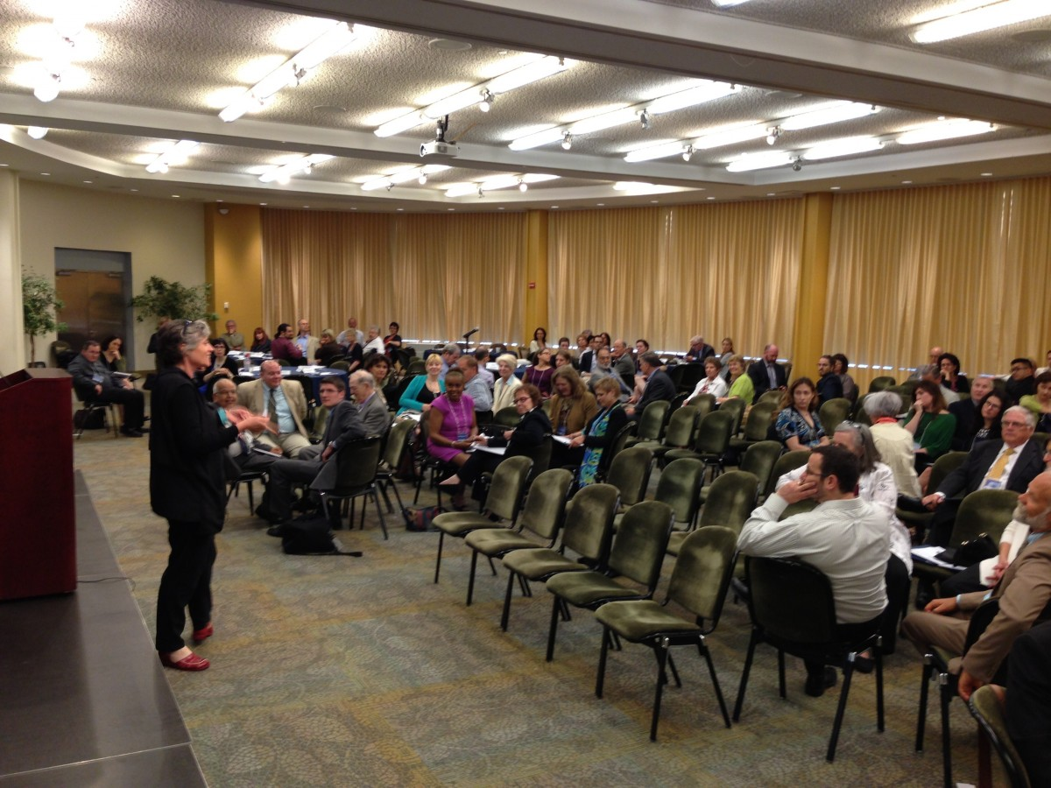

I. Program Overview
E. Program Goal
Navigation Services
Suite of supportive services provided to help a returning resident overcome any barrier to a successful reentry to become socially and economically whole, thereby reducing the recidivism rate and improving the economy in Illinois.
Education and Workforce Development Services
  Place participants in one of the following before transitioning to the final phase:
  Unsubsidized Employment
  Post-Secondary Education
  Approved Apprenticeship
Retention
  Career Coaches and Reentry Navigators provide ongoing support during placement to ensure successful retention. All program supports are available to participants during retention. If placement is unsuccessful, program staff must identify additional placement opportunities and place participant again. Participants are exited from the program upon completion.
Road Home Agency Partner Manual

Slide 9
I. Program Overview
F. Performance Measures
Program Specific Measures
1. Placement into Education and Employment Has retention 3 months after initial placement Post-secondary education, apprenticeships, or vocational programs (case by case) | 70%
2. Industry Recognized Credential | 60%
3. Recidivism Rate | 25%
Road Home Agency Partner Manual

Slide 10

II. Business Engagement
A. Paid Work Experience
A paid work experience or subsidized internship is a planned, structured learning experience that takes place in a workplace for a limited period. Paid work experiences or subsidized internships may be paid or unpaid, and consistent with other laws, such as the Fair Labor Standards Act. A paid work experience or subsidized internship may be arranged within the private for-profit sector, or the public sector.
B. On The Job Training (OJT)
On-the-Job Training provides reimbursements to employers to help compensate for the costs associated with for newly hired employees and the lost production of current employees providing the training (including management staff). OJT training can assist employers who are looking to expand their businesses and who need additional staff trained with specialized skills. OJT employers may receive up to 50% reimbursement of the wage rate (in certain circumstances up to 75%) of OJT trainees to help defray personnel training costs. Under some programs, such as those funded by H-1B fees, OJT reimbursement may be as high as 90%, depending upon employer size.
For additional information, contact the Chicago Cook Workforce Partnership, any of its 91 delegate agencies, American Job Centers

Slide 11
II. Business Engagement
C. Develop Quality Paid Work Experiences:
Road Home partner agencies are responsible for recruiting businesses in target that are committed to developing the next generation of justice impacted workers to serve as Internship Host Sites. Quality is the primary focus of business partnerships. It is important to be transparent about program requirements, and clear when communicating your expectations of Internship Host Sites. Opportunity Works Internships must be valuable to the employer and provide participants with exposure to viable career pathways that includes relevant info and experience.
Before placing participant with business, you must:
- Conduct Business Orientation
Review Road Home model, and the roles and responsibilities of all partners.
Must use Business Orientation PPT; also, see sample Business Orientation Agenda.
- Obtain signed Host Site Agreement that clearly defines relationships and responsibilities of all involved parties.
- Obtain or develop internship position description and complete an Internship Training Outline (ITO) in partnership with business partner.
Place copies of Host Site Agreement, Position description, and ITO in participant files.
- Enter all Host Site information in the Program Data Tracker placement detail tab.

Slide 12
II. Business Engagement
Internship Development Tools
Along with the Host Site Agreement and Business Orientation Presentation, The Partnership requires the use of the Internship Training Outline (ITO) in guiding the creation and customization of The Road Home internship placements.
The ITO is a tool used by partner agency staff and site supervisors to focus on the learning of participants during their internship.
–Work with the business to record the skills that can be learned by the participant in the ITO.
–Include skills that are relevant to the work environment, as well as to the specific to the intern who has been matched with the business. Skills can include a range of requirements like showing up on time or programming a CNC router.
The position description is created by the business or the partner agency and should describe proposed activities the participant will be completing.
–Can be in the format preferred by either the business or partner agency.
–The position description is not customized to the intern.
–The Partnership encourages delegate agencies to use sample language from O*NET OnLine at onetonline.org in developing position descriptions.

Slide 13
II. Business Engagement
Maintain Quality Internships
The Road Home partner agencies maintain high quality internship placement opportunities while participants are completing their internship and throughout the entirety of the grant period. At a minimum, program staff must:
–Visit each Host Site at least two times to check in with participant and supervisor.
• Make sure participant is engaged in activities related to internship description and ITO
• Assist supervisor and/or participant in addressing any challenges at Host Site.
• Complete Host Site Visit Report for all formal visits and keep a copy in the participant file.
• Use the results from Working Impact surveys during final site visit to provide interns with an honest and supportive assessment of their performance. (See section III.H for more info.)
• Include Business Relations and Economic Development staff from The Partnership whenever possible.
• Ensure that all host sites have a Medical Release Form for their Opportunity Works interns on site.
–Host events to build stronger relationships with businesses. At a minimum, invite businesses to participate in:
• Business orientation
• Mock interview workshops and hiring events
• Participant Milestone Celebrations
–Immediately notify The Partnership if a business partner behaves inappropriately or is not satisfied with The Road Home Services.

Slide 14
II. Business Engagement
D. Paid Training – Individual Training Account (ITA)
ITA Procedure form
ITA FAQ's update

Slide 15
III. Reentry Navigation
  Recruitment and Eligibility:
  Prior to Enrollment
Justice Partners (i.e., IDOC, Cook County Jail) will identify eligible participants returning to Cook County who are one to three months from their release date, and will provide this information to Reentry Navigators for processing. Eligible candidates will be selected from the Cook County Jail (excluding pretrial detainees), and from three IDOC facilities: Kewanee Life Skills Reentry Center, Murphysboro Life Skills Reentry Center, and Logan Correctional Center.
Road Home Agency Partner Manual

Slide 16
III. Reentry Navigation
  Recruitment and Eligibility:
  Target Populations
  – Impacted by the cook county criminal justice system or justice involved.
  Partner agencies must certify eligibility prior to enrolling participants in the Career Connect Program Application for The Road Home; and they must collect and add the required eligibility documentation to the participant’s file. Participants may complete a self-attestation form to document unemployment and/or an employment barrier.
  See Section 1 of the File Coversheets - Attachment 31, and Attachment 13 for further guidance on documenting target population eligibility based on income.
Road Home Agency Partner Manual

Slide 17
III. Reentry Navigation
  Phase I Prerelease
  B. Screening and Enrollment
  Screening and Intake (1 month)
  Navigators screen potential participants for eligibility and suitability.
  Selected candidates attend an orientation that includes:
  Program Overview
  In-Depth Assessment (see attachment)
  MSR Mandates and Requirements Navigation (see attachment)
  Completion of necessary enrollment forms (see attachment)
  Individual Career Plan (see attachment)
Road Home Agency Partner Manual

Slide 18
III. Reentry Navigation
  Phase I Prerelease
  B. Screening and Enrollment
  Use evidence-based and effective tools to assess applicants to determine suitability for The Road Home and to learn more about the applicant’s background, skills, aptitude and interests.
  – Use formal and informal tools.
  – Consider previous experience as well as current interest and motivation. One of the top indicators of applicant success, as noted by RFI responses from businesses, is an eagerness to learn and engage in work activities.
  – The Partnership does not require The Road Home agencies to use TABE 11/12 to assess participants but does encourage use of uniform assessment processes to objectively assess applicants.
  If someone is eligible, suitable, and they want to participate – sign them up! You must enroll the participant before they begin training. To enroll, complete the following steps:
  – Complete the Career Connect Registration and Application for The Road Home.
  – Begin a participant file to maintain and store physical records.
  Complete the paper enrollment forms:
  • Career Connect Consent
  • Media release
  • Program Consent
Road Home Agency Partner Manual

Slide 19
III. Reentry Navigation
  Phase I Prerelease
  C. Navigation Services
  Reentry Planning (3 months)
  Reentry Navigators meet with participants and begin addressing barriers identified in screening assessment (i.e. documentation, housing, food and health benefits, parole mandates and requirements [i.e. electronic monitoring, GPS, home detention, anger management, substance abuse, etc.]).
  Reentry Navigators identify agency(s) best suited for each participant based upon geographical area program participant is returning to and connect him/her with their assigned Career Coach.
Road Home Agency Partner Manual

Slide 20
III. Reentry Navigation
  Phase II Community Based Resources
  Basic Needs, Reentry, Education, and Workforce Development Services (9 months)
  A. Basic Needs
  Immediately upon return to the community Career Coaches will address the most basic needs of program participants that they were not able to provide prerelease, including, but not limited to, documentation assistance, clothing, food security, health insurance, housing, mental health, and substance abuse services.
Road Home Agency Partner Manual

Slide 21
III. Reentry Navigation
  Phase II Community Based Resources
  Basic Needs, Reentry, Education, and workforce development Services (9 months)
  B. Reentry
  Participants will have access to a suite of supportive services including, but not limited to, transportation assistance, cognitive behavioral therapy, trauma informed care, digital literacy, legal aid, adult living classes, legal aid, family engagement, six-week paid work experience, and access to a Barrier Relief Fund to overcome any barriers once back into the community.
Road Home Agency Partner Manual

Slide 22
III. Reentry Navigation
  Phase II Community Based Resources
  Basic Needs, Reentry, Education, and workforce development Services (9 months)
  C. Education
  Participants will have access to GED prep courses. For those who have already obtained a high school diploma or equivalency, post-secondary, or short-term training opportunities will be identified.
Road Home Agency Partner Manual

Slide 23
III. Reentry Navigation
  Phase II Community Based Resources
  Basic Needs, Reentry, Education, and Workforce Development Services (10 months)
  D. Workforce Development
  All program participants will receive soft skill training and will then continue their career pathway based on their individual goals. Co-enrollment with WIOA, subsidized paid work experiences, career exploration, Individual Training Accounts, On-the-Job Training, Apprenticeships, short-term training programs and other activities will prepare candidates for unsubsidized placement.
Road Home Agency Partner Manual

Slide 24
III. Reentry Navigation
  Phase II Community Based Resources
  Prior to Retention
  E. Placement
  Participants must be placed in unsubsidized employment, post-secondary education, or an approved apprenticeship before transitioning to the final phase of the program, which is retention.
Road Home Agency Partner Manual

Slide 25
III. Reentry Navigation
  Phase III Retention
  Placement Support
  A. Retention Activities (3 months)
  Career Coaches and Reentry Navigators provide ongoing support during placement to ensure successful retention. All program supports are available to participants throughout the duration of the program. If a placement is unsuccessful, program staff must identify additional placement opportunities and place participant again. Participants are exited from program upon completion.
Road Home Agency Partner Manual

Slide 26
VI. Reporting and Administrating
  Tracking Program Data
  Partner agencies are required to use Career Connect, The Partnership’s case management and business services data management system, to enroll participants and to track all services and outcomes. Specifically partner agencies must:
  — Use the Program Data Tracker to compile core program information and guide career connect program documentation.
  — Complete a Career Connect Registration form for all participants, this form may be completed partially by the applicant.
  — Complete the Career Connect Road Home Application for participants you want to enroll into the program.
  — Track key services in Career Connect. Some services will have a start and end date, while others will be recorded as transactional “same day” services.
  — Ensure that participant case file includes relevant documentation.
  — Track key outcomes in Career Connect. Ensure that participant case file includes relevant documentation.
  — Utilize the Career Connect Services overview table to guide program activity documentation.
  — Enter case notes on each participant at least once a month while the individual is participating in The Road Home.
  — If a partner agency plans to leverage program funding from both The Road Home and WIOA, they must follow the process outlined in WIOA.
  — Program evaluations are tracked using Working Impact Surveys.
  Partner agencies must also maintain physical files on each participant enrolled in Opportunity Works, organizing the files in the order specified in the File Coversheets.
Road Home Agency Partner Manual

Slide 27
VI. Reporting and Administrating
B. Reporting and Performance Management:
In addition to tracking participant information, services and outcomes in Career Connect in a timely manner, partner agencies must also provide the following reports:
Weekly program update emails to Reentry Navigators
Brief monthly qualitative reports during the initial phase of the project, using a template provided by The Partnership. Reports will be due on the 1st of the month, the preceding Friday if the 1st falls on weekend.
Monthly quantitative report that shows progress towards meeting contract goals, using a template provided by The Partnership. Agencies and The Partnership will agree to monthly goals at the start of the program.
Fiscal reporting is completed by submitting monthly reimbursement vouchers.
The Reentry Navigators will conduct routine site visits to assess progress, provide technical assistance and document lessons learned. The Reentry Navigators will also convene meetings with the procured agencies on a regular basis.
Road Home Agency Partner Manual

Slide 28
VI. Reporting and Administrating
C. Program and Fiscal Monitoring:
The Partnership will conduct regular program monitoring through data analysis, site visits, and file audits. Partner agencies are expected keep updated records in Career Connect and paper participant files documenting their engagement with program services.
Partner agencies should be prepared for an early fiscal monitoring visit to ensure that proper policies and procedures are in place to ensure appropriate use of The Reentry Navigation: The Road Home funds.
New partner agencies should be prepared for an early fiscal monitoring visit to ensure that proper policies and procedures are in place to ensure appropriate use of The Road Home funds.
The Program Coordinator will conduct routine site visits to assess progress, provide technical assistance, and document lessons learned. The Program Coordinator will also convene all partners on a regular basis.
Road Home Agency Partner Manual

Slide 29
VI. Reporting and Administrating
D. Communications Guidelines
Partner agencies should promote The Reentry Navigation Initiative: The Road Home, to connect with potential business partners through outreach practices that are appropriate for your networks and communities.
The Partnership has provided outreach materials to engage businesses and young adults. If you wish to create other materials or brand other items for The Road Home, use the provided logos and request approval from Joshua Williams via jwilliams2@chicookworks.org.
The Partnership has provided outreach materials to engage businesses and returning residents. If you wish to create other materials or brand other items for The Reentry Navigation Initiative: The Road Home, you must request approval. If you are planning a public event for The Reentry Navigation Initiative: The Road Home, let Joshua Williams know the details of the event.
If you receive an inquiry from the news media about The Reentry Navigation Initiative: The Road Home, inform Joshua Williams as soon as possible.
When referring to the Chicago Cook Workforce Partnership, please use our full name or “The Partnership.” CCWP is not an abbreviation for our organization.
Road Home Agency Partner Manual

Slide 30
E. Additional Guidance:
Contact Cynthia Rodrigues at The Partnership with any questions you have about implementing The Reentry Navigation Initiative: The Road Home programming.
crodriguez@chicookworks.org 312-833-7169
Contact Joshua Williams at The Partnership with any questions you have any questions relating to documenting The Reentry Navigation Initiative: The Road Home services in Career Connect.
jwilliams2@chicookworks.org 312-560-9980
Road Home Agency Partner Manual

Slide 31
VI. List of Attachments
  Reentry Navigation Initiative: The Road Home Orientation Power Point
  Participant Application (Eligibility/Suitability Assessment))
  Prerelease Reentry Packet
  MSR (Parole) Mandates & Requirements Navigation
  Individual Career Plan
  Trauma Informed Care Training Toolkit
  Barrier Relief Fund
  Business Orientation Agenda
  Host Site Agreement
  Host Site Info Sheet
  Host Site Visit Report
  Business Orientation Agenda
  List of American Job Centers
  Program Consent Form
  Paycheck/Stipend Receipt Log
  Support Services Documentation
  Petition for Termination of Mandatory Supervised Release
Road Home Agency Partner Manual

