Slide 1
EMPLOYER NAME
Workforce Services for Dislocated Workers
WIOA RAPID RESPONSE WEBINAR
DATE
Notes:
Add the name of the employer, and the presentation's date

Slide 2
AJC Representative Name
Title
CHICAGO COOK WORKFORCE PARTNERSHIP / AGENCY NAME
Notes:
Add the presenter' name, title, and the name of your agency

Slide 3
About The Partnership
The Partnership is the non-profit umbrella organization that oversees one of the largest public workforce systems in the country. As the designated administrator of federal workforce development funding for the City of Chicago and Cook County, The Partnership manages a network of approximately 70 community-based organizations, including American Job Centers and Career Centers, serving youth and adults. We also oversee a diverse portfolio of workforce initiatives representing corporate and philanthropic funds leveraging non-federal workforce development funding. For more information, visit https://chicookworks.org/.
Focusing on the region’s labor market, The Partnership provides training, business services, career coaching and data analysis, in the following high-growth and high-demand industries:
Business and Professional Services
Healthcare
Retail, Culinary, and Hospitality
Information Technology
Manufacturing
Transportation, Distribution, and Logistics
Construction
Notes:
No changes are required.

Slide 4
Partnership Vision and Mission
Vision
Every person has the opportunity to build a career; every business has the talent to grow and compete in a global economy.
Mission
We champion a dynamic network of workforce development partners dedicated to unlocking opportunity and driving economic growth. Guided by a strong sense of fiduciary responsibility and strategic collaboration, we manage a network that designs forward-thinking solutions to meet the evolving needs of businesses, while preparing individuals not just for jobs, but for thriving, purpose-driven careers.
Notes:
No changes are required.

Slide 5






System Overview
Data and Analytics
Sector Strategies
Job Postings
Recruitment
Candidate Assessment
Employee Upskilling
Career Pathways
Talent Pipeline
Career Coaching
Individual Employment Plan
Training
Job Search
Job Seeker
Employer
Training Provider
Business Services Team
Chicago Cook Workforce Partnership
Career Coach
Notes:
No changes are required.

Slide 6
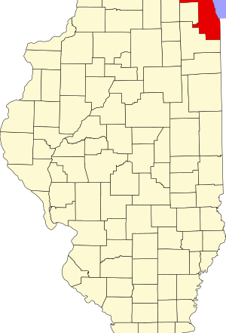
Region’s Labor Market
Business and Professional Services
Healthcare
Retail, Culinary, and Hospitality
Information Technology
Manufacturing
Transportation, Distribution, and Logistics
Construction
This Photo by Unknown Author is licensed under CC BY-SA
Notes:
No changes are required.

Slide 7
What is a Dislocated Worker?
Rapid Response Services
Provide information, available resources & programming for WIOA Dislocated Workers administered under the Cook County public workforce system – Local Workforce Innovation Area 7 (LWIA) or ‘The Partnership’.
To support affected workers who are facing an employment layoff at no fault of their own with employment services, programs, and resources that will prepare and support them in their re-employment efforts including and opportunity to train/re-train in sector & demand driven occupational training.
Have received notice of layoff or have been laid off due to company closure or re-organization resulting in a reduction in force or mass layoff.
Rapid Response services are set into action by receipt of the WARN Notice.
WIOA Dislocated Worker funding serves these layoff affected workers in their employment transition through workforce development programs & services.
Notes:
No changes are required.

Slide 8
What is WIOA?
Workforce Innovation & Opportunity Act - WIOA
Laid Off Worker programs & services for Dislocated Workers are made available through federal funding from the US Department of Labor.
WIOA funds the public workforce system throughout the USA through the American Job Center system.
WIOA funding provides re-employment preparation assistance, job placement support/assistance, and opportunity for occupational training leading to improved skill attainment and workforce marketability.
AT NO COST TO YOU! Tax Dollar funded program.
Notes:
No changes are required.

Slide 9
Get Started through WIOA
How can WIOA help & your next step:
WIOA dislocated worker program provides career services & resources, workforce readiness & training services for Laid Off Workers through the American Job Center and public workforce system.
In Cook County, the public workforce system consists of American Job Centers located in the City of Chicago and suburban Cook County, along with a network of expert workforce development organizations that are regionally located throughout Chicagoland.
Call the nearest, most convenient American Job Center nearest you and register for a Dislocated Worker Orientation session (held weekly, varies by Center) or request services online at ChiCookWorks.org under “Connect to American Job Centers”. Bring your Company separation letter, which validates your layoff & other required documents.
Notes:
No changes are required.

Slide 10
Career Success Through WIOA
Career Resources & Workshops
Career Coach & Job Search Assistance
Occupational Training Opportunities
Employment & Career Success
Resource Centers that can serve as your Work Office.
Use of Computers, Internet, Printers and more –at no cost.
One-on-One Career Coaching
Individual Employment Plan & Goals
Train in Demand Sector driven occupations
Business Service Teams that make connections to Employers and JOBS
*Healthcare *IT *Manufacturing
*Transportation & Logistics
*Hospitality, Retail
*Business & Professional Services
*Construction
Workforce-Job Readiness Workshops
Professional Resume Writing Assistance
Social Media Workshops
Job Search Services
Job Placement Services
Access to Labor Market Data
Mock Interview Preparation
Hire First On-The-Job Training Incentive programs
Notes:
No changes are required.

Slide 11
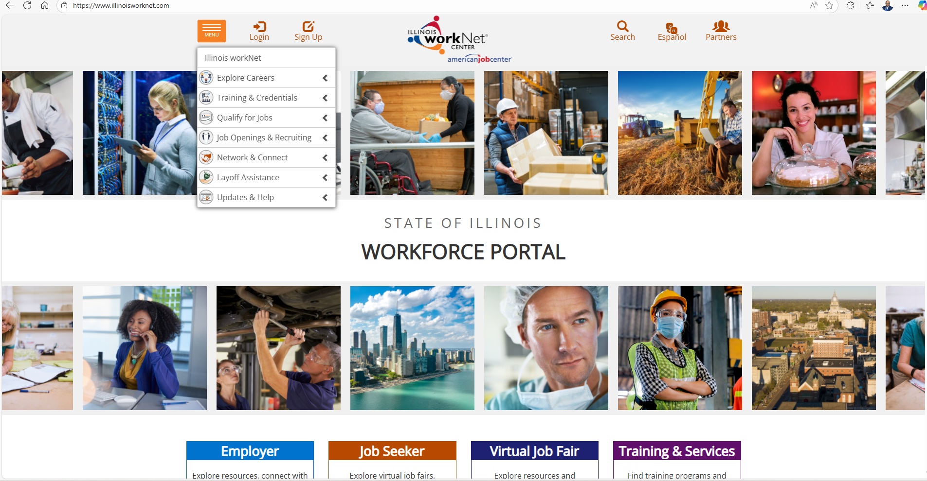
Illinoisworknet.com
Notes:
No changes are required.

Slide 12
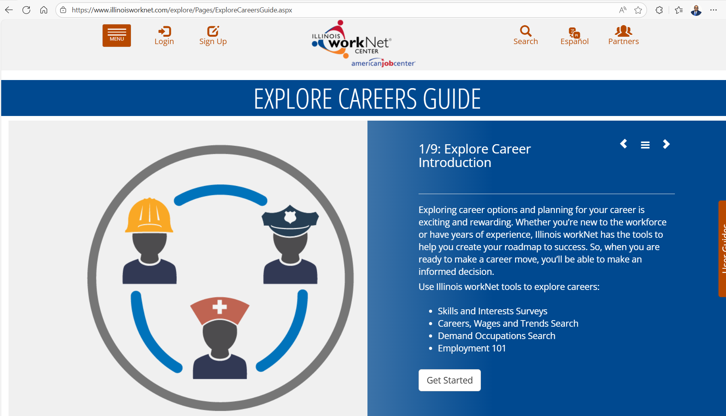
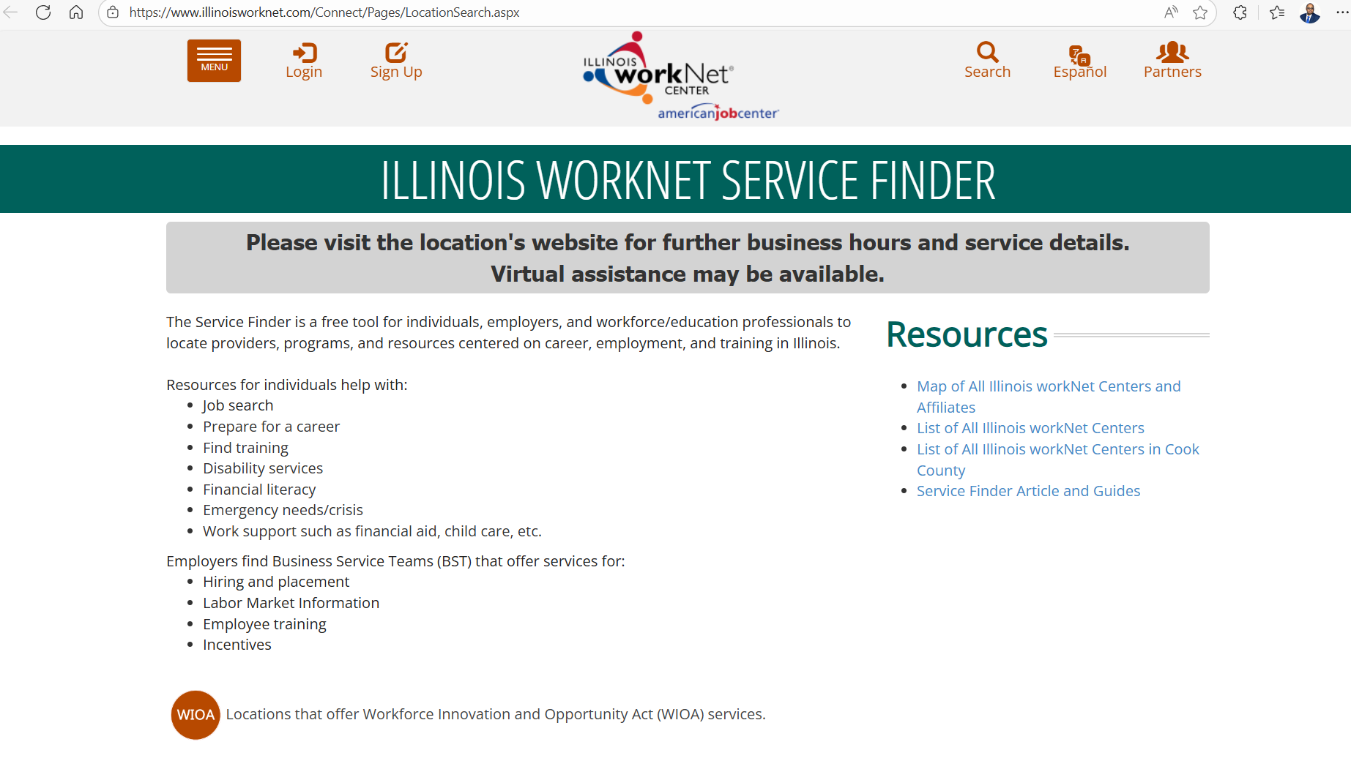
Illinoisworknet.com
Illinoisworknet.com is an online, 24/7 informational workforce development website that helps individuals plan and move forward in their job search & careers. It can also direct you to find the State of IL Health Insurance exchange or other support services.
Search for a Cook County American Job Center nearest you. You can filter/narrow your search by Zip Code, County, Keyword Search: Laid Off Worker Services.
Notes:
No changes are required.

Slide 13
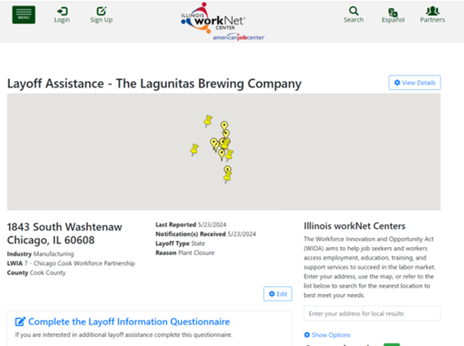
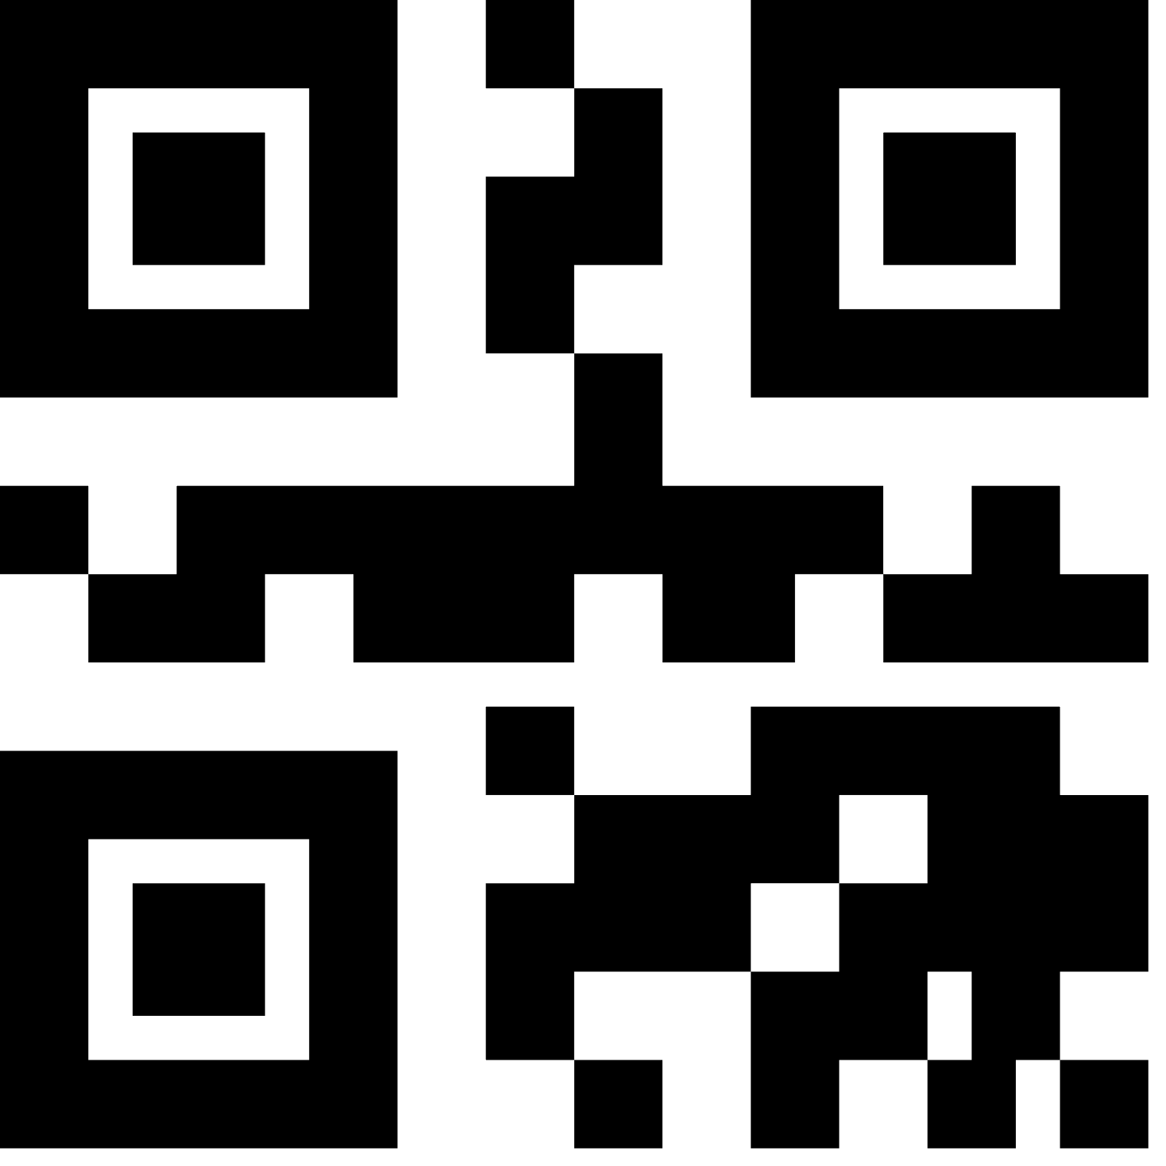
Illinoisworknet.com
Company Specific Layoff Page
This Photo by Unknown Author is licensed under CC BY-NC
Notes:
- Add company specific page QR code (size 2.54 x 2.54)
- Add company public page ( width 6.3 x height 4.7 )

Slide 14
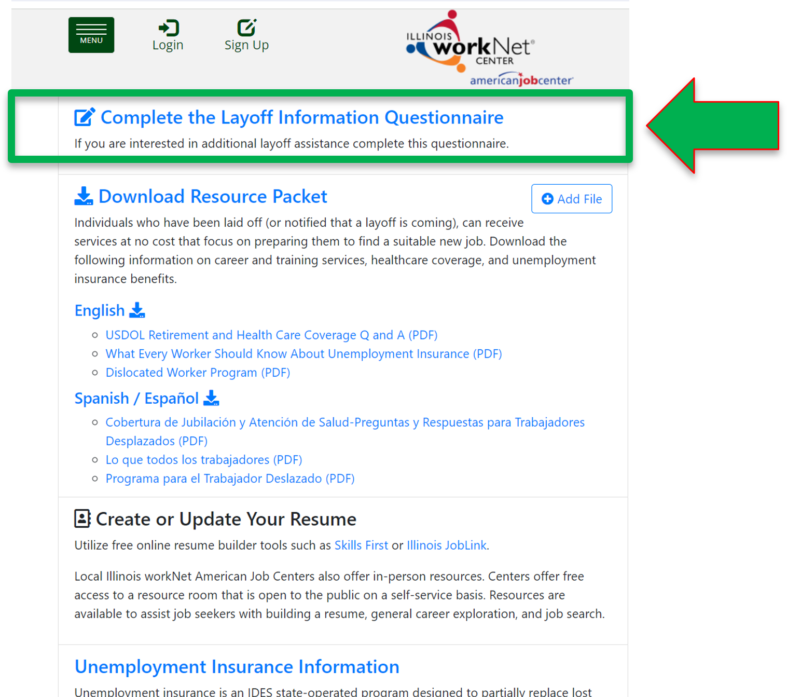
Illinoisworknet.com
Layoff Information Questionnaire
https://layoffs.illinoisworknet.com/EMPLOYER/questionnaire
This Photo by Unknown Author is licensed under CC BY-NC
Notes:
-Add company public questionnaire specific page QR code (size 2.53 x 2.53)
-Add company public questionnaire specific link

Slide 15
Questions / Thank you.
Notes:
No changes are required.

