Slide 1
ConstructionWorks
Powered by the Illinois Tollway

Slide 2
Driving Economic Opportunities
The Illinois Tollway is dedicated to providing and promoting a safe and efficient system of highways while ensuring the highest possible level of service to our customers.
$14B
Estimated spend for Move Illinois Capital Program
1.3M
Daily Drivers
294
Centerline miles
120k
Jobs created by Move Illinois Capital Program
5
Toll roads
12
Counties across Northern Illinois

Slide 3
Illinois Tollway Commitment to Diversity
The Illinois Tollway Department of Diversity and Strategic Development is a driving force for increasing economic opportunities in the diverse communities we serve.
ACCESS
PARTICIPATION
ADVANCEMENT
Inclusion Is The Foundation
As an economic engine for the region, the Tollway provides small, diverse and veteran businesses and individuals with opportunities to grow and succeed through our training programs, strategic partnerships and investments in infrastructure.

Slide 4
Start Your Career in Construction with ConstructionWorks
ConstructionWorks is a FREE program designed to help you discover job opportunities in Illinois’ high-demand transportation related construction industry. With a network of training partners throughout Northern Illinois, ConstructionWorks advances access to comprehensive job training, and promotes a path to long-term career success through support and retention services.
CUSTOMIZED TRAINING
CAREER PLANNING
ESSENTIAL AND GROWING INDUSTRY
WORK APPAREL AND TOOLS
SUPPORT SERVICES
TRAINING REFERRALS

Slide 5
Opportunities Ahead!
CAREERS OPPORTUNITIES
Equipment Operators
Carpenters
Electricians
Iron Workers
Cement Masons
Laborers
SUPPORT SERVICES
Transportation Assistance
Work apparel and tools
Application Fee Assistance
Childcare Assistance
Financial coaching
Drug counseling
Basic skills and adult education referrals
Ongoing retention support
Services are available at designated locations throughout Chicago, Cook County, DuPage County, Waukegan, Aurora and Rockford.

Slide 6
How it Works

Slide 7
Get Involved Today!
Ready to learn more? Your future awaits with the Illinois Tollway’s ConstructionWorks program through two simple steps.
1. Check Eligibility
18 years of age or older
Eligible to work in the United States
Unemployed, underemployed or seeking career growth in the construction industry
2. Complete Interest Form Online or In Person
Visit any one of our local ConstructionWorks centers to meet with a career coach and get started on advancing your career in construction. You may also visit tinyurl.com/constructionworks.

Slide 8
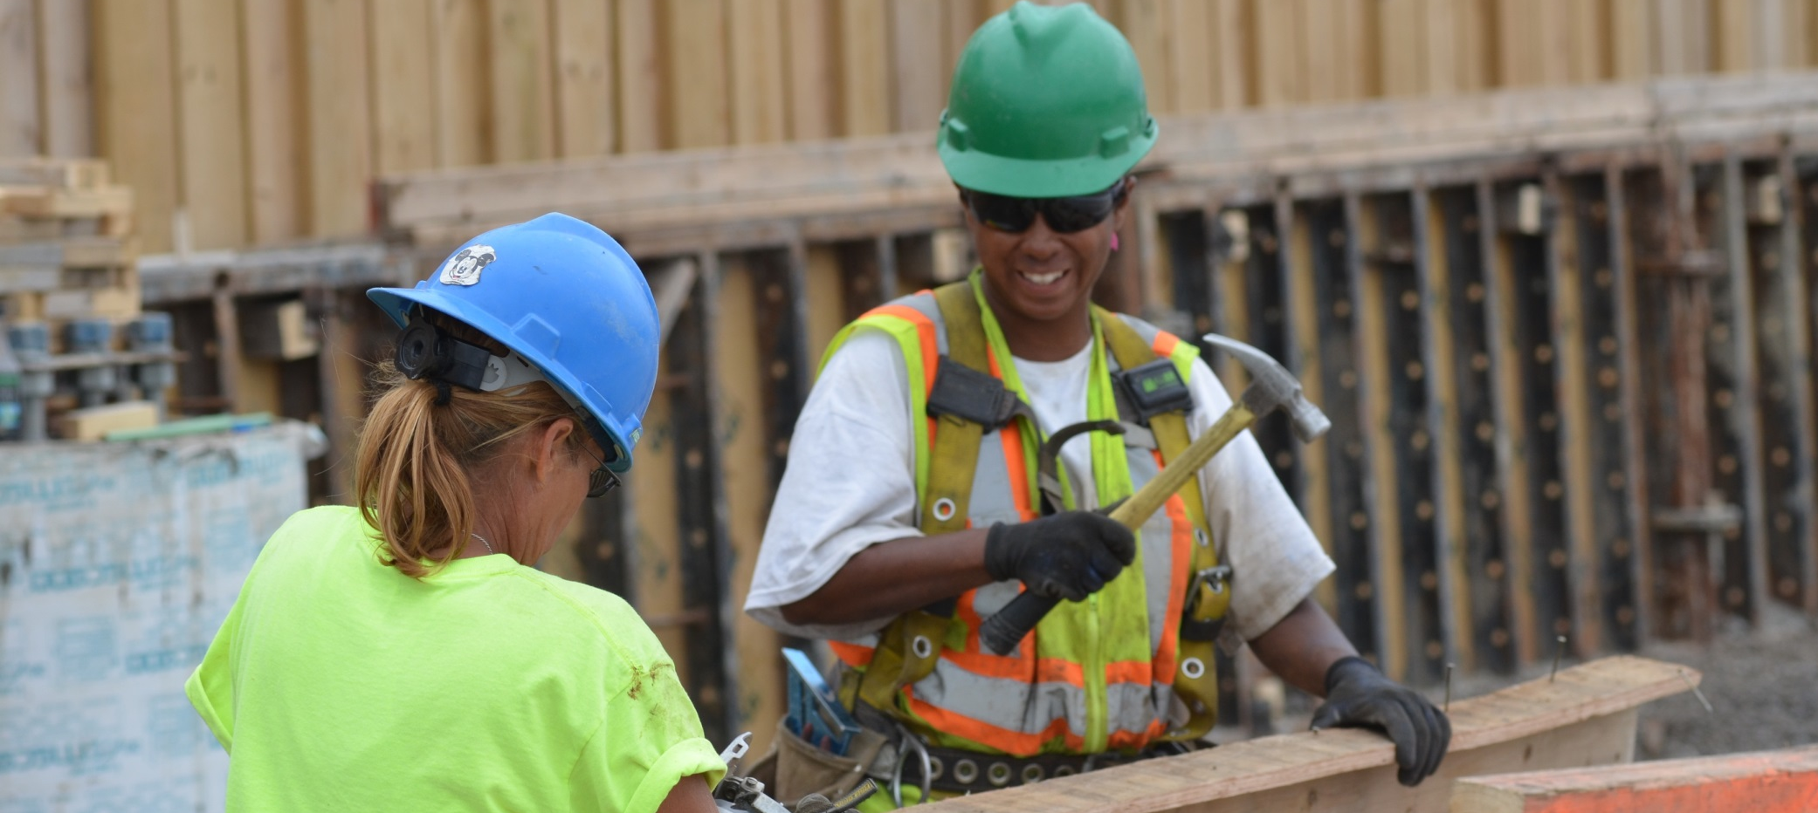
THANK YOU!

